Slide 1
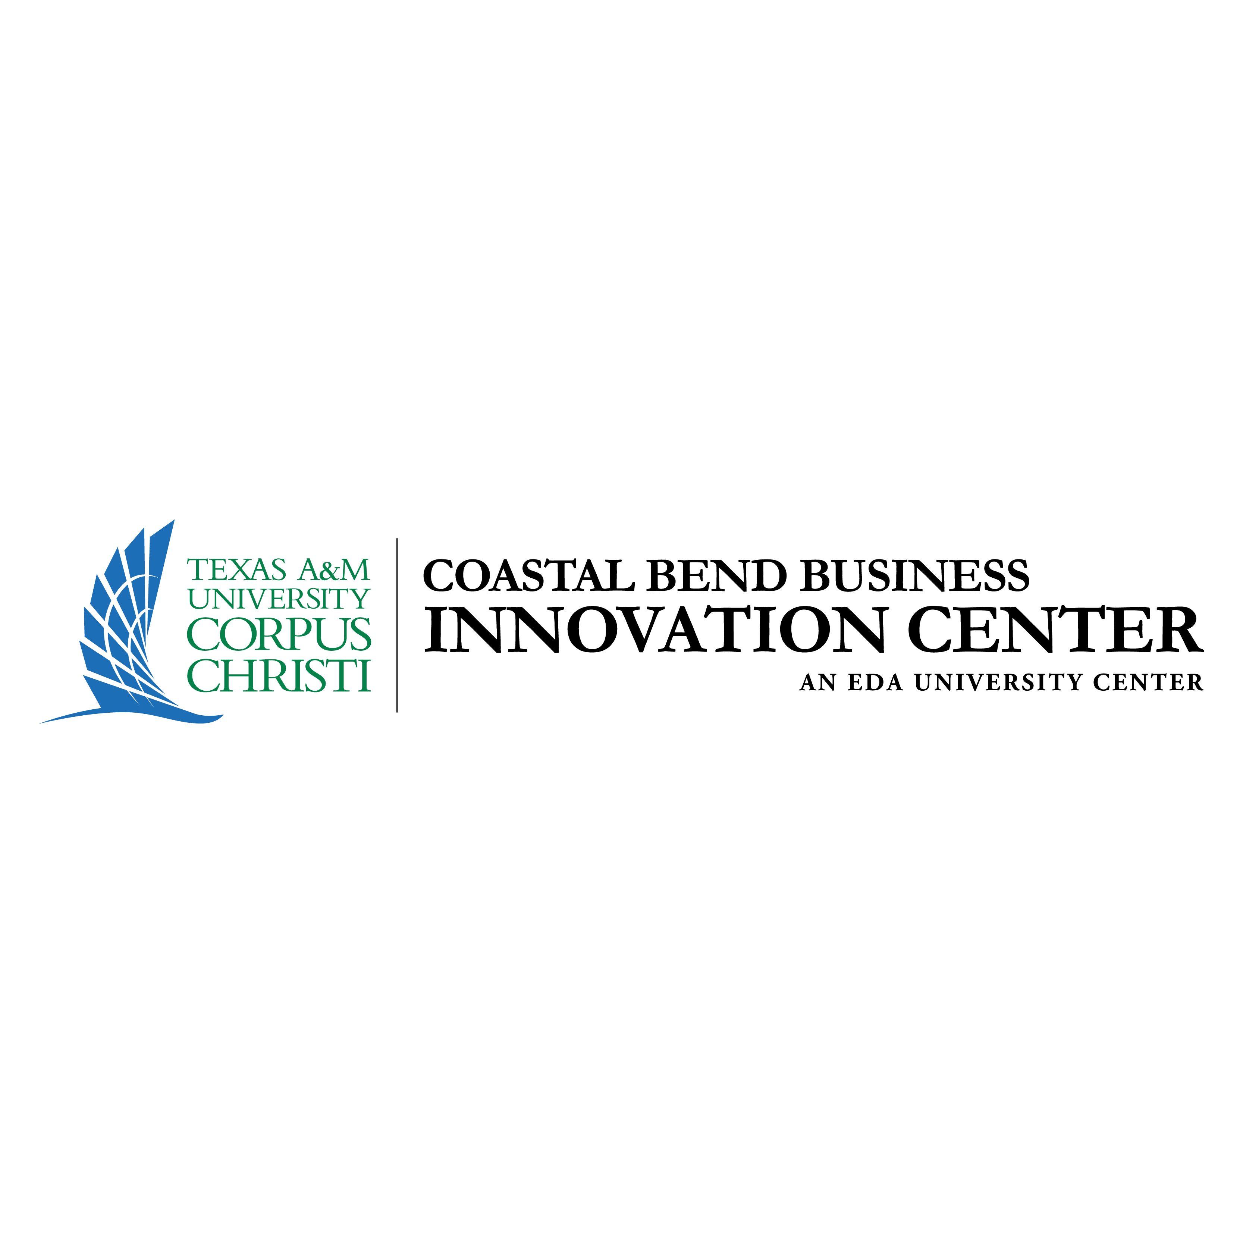

Re-Thinking Entrepreneurship –
Rural Communities as Start Ups
@UTAustin
Technology Cities
Remote Cities
Small Cities
Rural Communities
Activating Innovation, Creativity and Capital
Addressing Challenges in All Communities

Slide 2
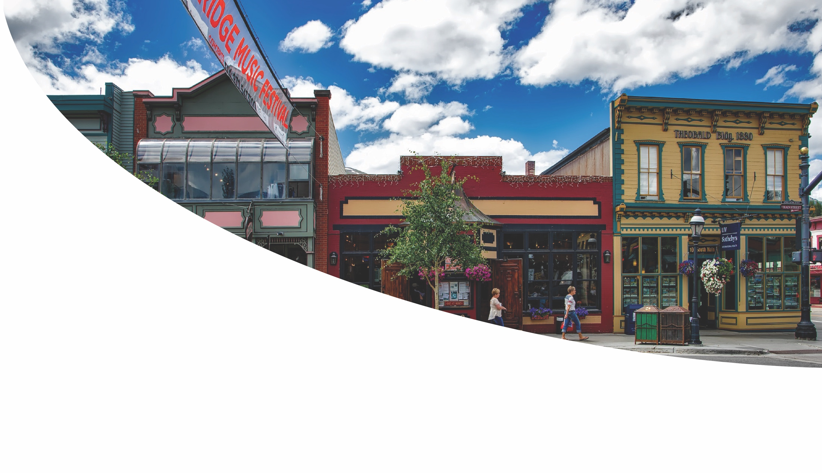
Overview
Collaboration between CBBIC and IC²
Evolved from collaboration on Connected Coast Summit Series Post-Hurricane Harvey
Strategy to improve opportunities for rural communities
Focus is on
  Growing future communities…
  Grounded in the collective community identity

Slide 3
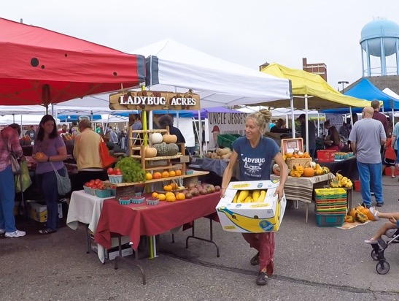
What Divides Urban and Rural Communities?
Post Great Recession, many rural residents are “frozen in place” due to:
  Decline in traditional industry
  Discrepancy in housing values
  Decreasing job growth
  Lower personal income growth
  Regional aging and declining birth rates
Key Challenges:
  Sensitivity to economic shocks
  Availability of and participation in technology
  Attainment of education
  Diversity of economic assets
  Out-migration of population

Slide 4
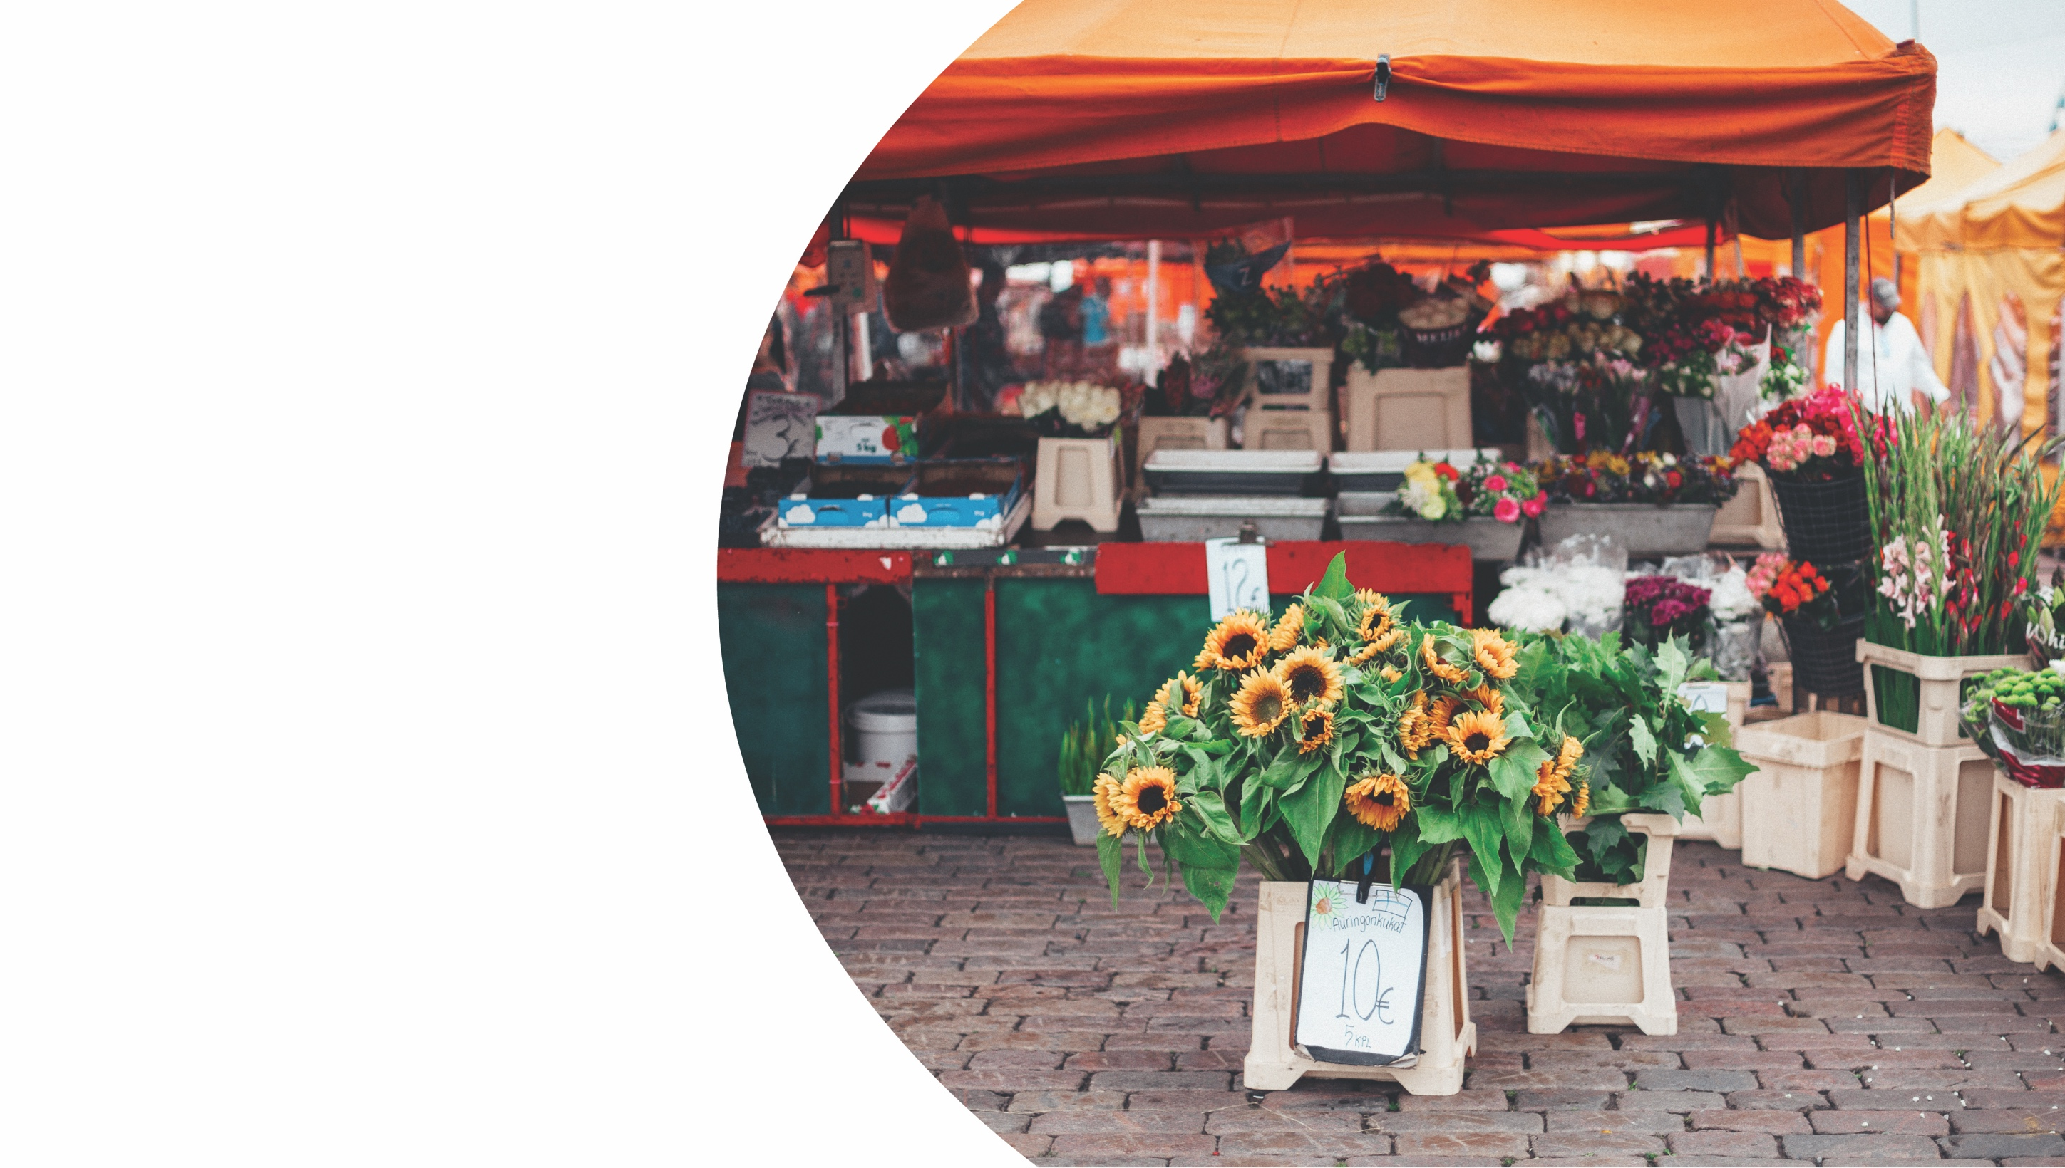
Collaborative Approach
Develop Custom Community Strategies that:
  Grow Communities considering identity
  Connect with regional communities
  Create businesses
  Create Jobs
  Develop resilience to economic and natural shocks

Slide 5
Need to Re-Think Entrepreneurship
Despite economic progress since 2008,
  Increasing distress among U.S. communities
  Growing disparity between current and predicted economic performance between rural/small cities and urban centers
How can this be reversed?
  Direct engagement in communities
  Linking community identity with innovation and entrepreneurial potential
  Re-thinking entrepreneurship and innovation to fit with the identity of non-urban regions
https://www.visualcapitalist.com/america-distressed-communities-2/

Slide 6
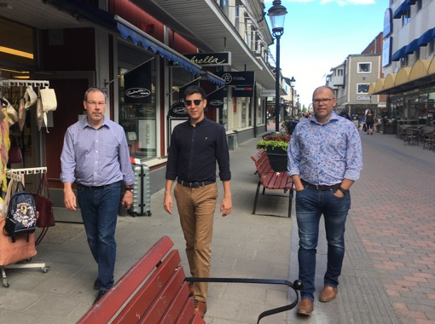
IC² Institute:
2018-2019 U.S. and World Small City Tour
Why?
  Get to know rural and small cities – directly;
  Understand community challenges;
  Determine regional opportunities;
  Explore common models for economic prosperity; and
  Re-think entrepreneurship to fit rural/small city exigencies.

Slide 7
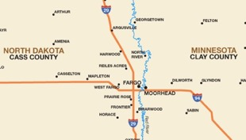
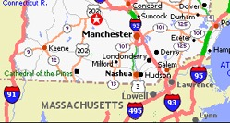
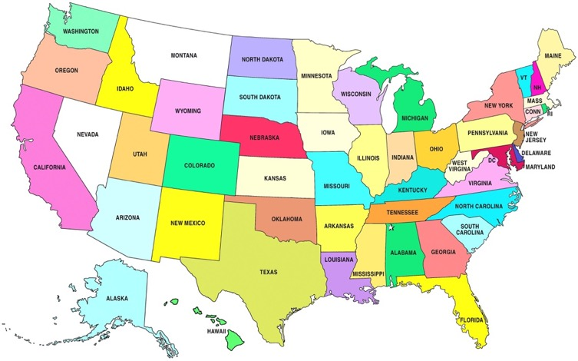
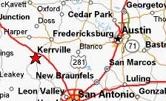
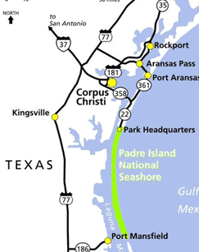
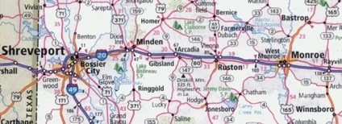
Japan
  Aichi Prefecture
Northern Sweden
  Four cities
India
  Three States
Keene
FARGO
BOISE
Austin
NW
Arkansas
Kerrville
Smithville
Texas Coastal
Bend
Northern Louisiana

Slide 8

Common Challenges
Distance
  Geography
  Accessibility
  Linking “Think” and “Do”
Dilution
  Talent and Innovation
  Experience
  Focus
Demand
  Funding access
  Investor interest
  Deal flow
Draw-In/Engage
  Industry engagement
  Student retention
  Need for regional tethering not necessarily emulating
Notes:
Distance
Geography
Accessibility
Linking “ars” and “invenio”
Dilution
Talent and Innovation
Experience
Focus
Demand
Funding access
Investor interest
Deal flow
Draw-In/Engage
Industry engagement
Student retention
Need for regional tethering not necessarily emulating

Slide 9
Talent:
THE Key for Future Communities
Talent is necessary to:
  Build local culture;
  Grow existing businesses;
  Recruit and support new businesses;
  Create innovative businesses; and
  Govern effectively.

Slide 10
Talent Has a Choice…….
The necessary match between regional and personal:
  Values;
  Relational opportunities;
  Lifestyle;
  Meaning in work; and
  Economic opportunity;
Communities must:
  Invest in talent in region:
  Attract new talent; and
  Retain talent.

Slide 11
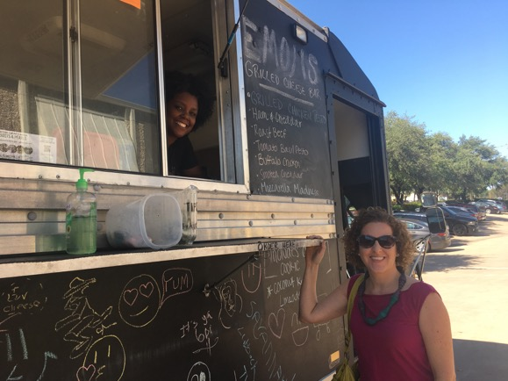
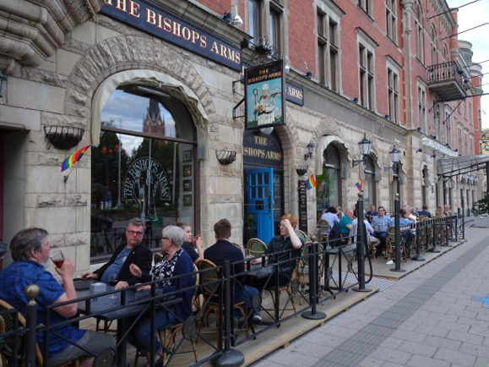
What is the Soul of Your City?
Place
  Values
  Spaces
  Lifestyle
People
  Talent
  Creativity
  Growth
Partnerships
  Interactions
  Collaborations
  “Making”

Slide 12
Community Identity
Values
Assets
Goals
Identity
Constraints
Tomorrow’s economic growth will come from understanding the “Soul of your City:”
  Growing local businesses;
  Recruiting new businesses; and
  Attracting talent.

Slide 13
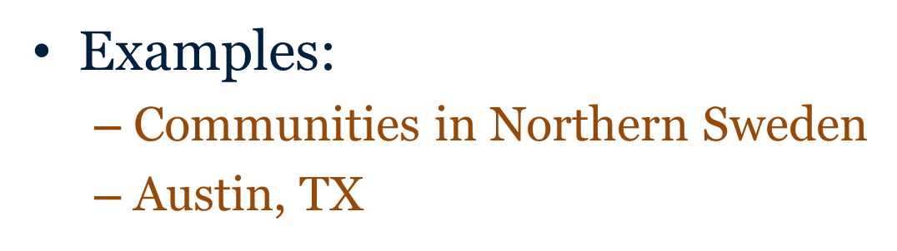
What Happens When a Community Builds from It’s Identity?

Slide 14

IC² Institute/UT Austin Collaboration with Northern Sweden (2012-2019)
Dissemination to Four Cities by LTU
Luleå
Piteå
Skellfeteå
Kiruna
Converting Technology to Wealth Course
Aspiring Women Entrepreneurs
“Gone to Texas” SXSW Accelerator
11 LTU Employees
6 LTU Students
Austin Sister Science City Relationship
16 ABI Companies
Luleå Mayor and team

Slide 15
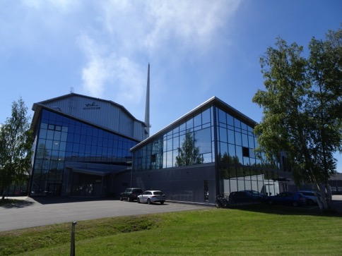
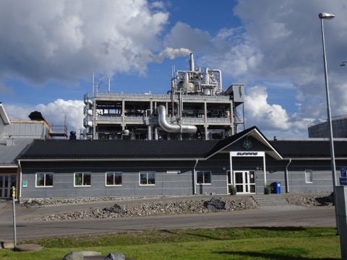
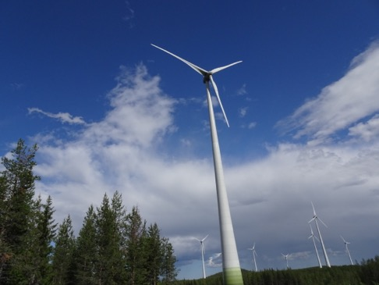
Sweden: Technology-Business Growth
Recruitment of 64 data centers including Facebook
Build out of excess affordable based on clean technology:
  Hydro-power
  Largest windfarm in EU
  Two at-scale biodiesel plants
Growth of automotive technologies of the future
  Largest Li-ion battery plant in the EU
  Test site for major auto and tire companies
Space technology hub
  Satellite launch
  Big data analysis
Startup hub
  Technology
  Creatives
  Music

Slide 16
So, Where is this Happening?
Kiruna
Luleå
Piteå
Skellefteå

Slide 17
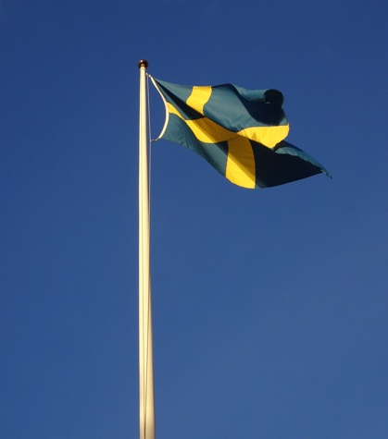
Northern Sweden Communities
Luleå
  77,100 population
  University and steel town
  Node Pole
  Startup hub
Kiruna
  23,000 population
  Steel mine
  Moving city center!
  Space technology
Piteå
  42,000 population
  Forestry – paper, CLT
  Summer town – games and music
  Clean energy production
Skellfeteå
  72,000 population
  Mine – high value metals
  Battery manufacturing
  Creative hub

Slide 18
Regional Synergies
Clean Tech
  Hydro-power
  Bio-Diesel
  Battery
  Wind
Creative
  Music
  Gaming
  Be Creative
Data
  Storage
  Satellite
  Startups
Automotive
  Testing
  Tires
  Driving culture
CleanTech
Automotive
Data
Creative

Slide 19
This Happened in Texas Too!
Vision
Catalyst
Incubator
Mentors and Fund
Growth
Austin, TX
Startup Capital U.S.:
Post-2010, Austin becomes THE place to startup.
Tech Councils, Texas Capital Network:
Starting 1992 and 1994, organizations provide mentors and angel funding to startups.
Austin Technology Incubator:
Born in 1989, ATI grows startups and retains students in city.
MCC, DELL, and MootCorp:
In 1983, technology design, manufacturing and business plan competition are launched.
Kozmetsky and City Leaders:
Starting in 1971, speaking that Austin’s identity fits as a regional technology manufacturing center

Slide 20
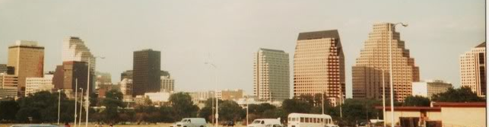
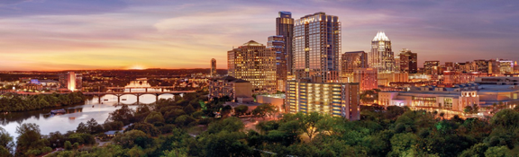
Austin, TX – An Innovation Hub
1980’s
Today
Number 1, Best Places to Live in the U.S. 2019: US News and World Report (US News and World Report) - 3rd straight year (2017-2019): Five metrics: job market, value, quality of life, desirability and migration
Number 1. Surge City: Best Place to Start a Business in America (Inc. Magazine, January 2019)
Top 3 Big Cities to Live in 2018 (WalletHub; July 2018) Five metrics: affordability, economy, education and health, quality of life, safety
Number 1. Global Cities (Savillis, World Economic Forum, June 2017)
Number 1 or 2 Startup Metro. Kauffman Foundation Startup Metro Activity and Entrepreneurship Metro Activity – 2015-2017

Slide 21
Example IC2 Institute Regional Outcomes
Program | Outcomes
Northern Louisiana | Set up of two Angel Investment Funds; $7.7 M raised
NW Arkansas | Launch of Data Science degree (UA); Focusing innovation centers of JB Hunt and Tysons to NWA; Plug and Play collaboration; UA regional entrepreneurship program
Northern Sweden | LTU Business programs in region and throughout EU; Startup acceleration program around SXSW; Shared student entrepreneurship programs
Aichi Prefecture, Japan | International startup marketplace program; Prefecture innovation and entrepreneurship strategy
Keene, NH | Hannah Grimes Center initiated $200K revolving loan program for new businesses; IC² plenary talk at Radically Rural Fall 2019
Fargo, ND | Creation of the Challey Institute’s New American Entrepreneurship program with Emerging Prairie; Student engagement in One Million Cups
Boise, ID | IC² speaking at Boise Startup Week Fall 2019

Slide 22
“City as a Startup” Model
Identity-Based Economic Development
Incubate Economic Future
Accelerate Partnerships
Discover Community Identity

Slide 23
Goals
Align people, organizations and innovation into a community ecosystems to:
  Attract talent,
  Enhance quality of life,
  Build economies and
  Create shared prosperity
Grow communities resilient toward future opportunities and challenges.

Slide 24
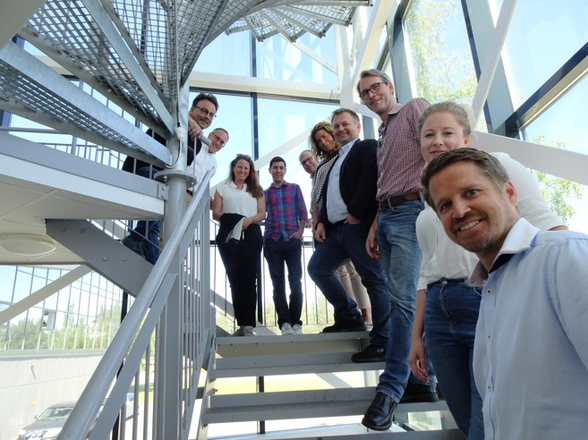
Northern Sweden Challenges
What is needed?
  Talent – lots of it
  Improved diversity of:
    Restaurants;
    Clubs;
    Music venues and events;
    Biking and walking trails;
  Lateral job opportunities
  Housing – sufficient and affordable
  Welcoming attitude for change and new people in city
  Engagement of traditional businesses to “give ideas a place”

Slide 25
“Community as a Startup” Model
Identity-Based Economic Development
Discover community identity
  Understand community identity
  Set goals
  Develop value proposition
Accelerate partnerships
  Engage partnerships in region
  Determine external partnerships needed
  Test value proposition to join community journey
Incubate economic future
  Initiate programs to grow company and talent engagement
  Develop structures, organizations and services
  Measure outcomes

Slide 26
Discover Community Identity
Gather objective data:
  Benchmark economic activities and performance
  Benchmark educational activities and performance
Discover community:
  Values
  Assets and Constraints
  Goals
Identify challenges and opportunities
Agree on business focus
Pivot innovation and entrepreneurial goals toward identity

Slide 27
Accelerate Partnerships
Agree on identity-based pitch
Activate “5M” community:
  Mentors, Makers, Market Access, Management and Members
Pitch community value proposition for:
  Engagement of anchor companies;
  Outside companies to consider relocation to region; and
  Talent to come to community for career opportunities
Pivot pitch based on feedback
Pitch community value proposition at SXSW in Austin, TX:
  Engage regional and out-of-region partners, investors or collaborators
  Pivot message to create magnet for companies and talent

Slide 28
Incubate Economic Future
Initiate business growth programs
Develop support structures and services to support goals, e.g.:
  Broadband
  Incubation or co-working spaces
  Funding programs – loan and equity
  Events, etc.
Collaborate to link students, company owners/workers, community leaders and entrepreneurs to achieve goals
Recruit companies and talent according to plan
Measure outcomes

Slide 29
Time of Great Opportunity
“Community as a Startup” will:
  Build on region’s core identity;
  Focus efforts and assets;
  Establish the regional social infrastructure to grow entrepreneurship;
  Engage communities, industry, educational institutions, support groups and policy makers; and
  Support new business start and recruitment.
Physical Infrastructure
to
Human Infrastructure
Notes:
Building an entrepreneurial ecosystem requires building a purposeful social infrastructure
Creates region-wide social clustering and innovation through weak ties;
Answers the question, “What do people ‘build’ together in the region?”
Requires the same focus, determination and patience to build as physical structures;
Offers region different ROI measures and advantages;
NW Arkansas can become a model for the nation.

Slide 30
Strategy Implementation Timeline
Month
1 2 3 4 5 6 7 8 9 10 11 12
Program
Start
Sociological
Assessment
Report
Education
Benchmarking
Report
Austin-Based
Acceleration
Immersion
Acceleration Report
With Incubation
Roadmap
Regional
Hackathon and
Assessment
Visits
Economic
Benchmarking
Report
Regional Roadmap
Development
Incubation
Program
Launch
Program
Assessments
Follow-up Program Launch
  Hack Community Identity
  Accelerate Partnerships
  Incubate Economic Future
Program Assessment
  Measure Key Outputs
  Compare with Benchmark
  Recommend Refinements

Slide 31
Why we are Here
Launch in Coastal Bend Region
Build Rockport as the showcase model with persistence
Facilitate Future Communities

Slide 32
What Will Your Future Be?

Slide 33
Re-Thinking Entrepreneurship
Rural Communities as Start Ups
@UTAustin
Technology Cities
Remote Cities
Small Cities
Rural Communities
Activating Innovation, Creativity and Capital; Addressing Challenges in All Communities
  Gregory P. Pogue, Ph.D.
  Deputy Executive Director
  gpogue@ic2.utexas.edu; +1-512-560-3717
  ic2.utexas.edu
  Russell Franques
  Director
  Russell.Fanques@tamucc.edu; +1-361-825-3525
  cbbic.tamucc.edu

Slide 34
Why Are We Engaging in this Divide?
Driving Force:
  Identify unstructured problems, complex economic issues,
  Gain deep understanding
  Create models
  Test, iterate and create economic impact
Historic Focus:
  Uniting innovation, creativity and capital to impact regional economies
  Developing an innovation ecosystem model facilitating startup creation in urban environments containing research universities
New Initiative:
  Developing new innovation ecosystem models for rural and remote cities
  Catalyzing programs to enhance competitiveness, wealth creation and future outcomes in these regions
@UTAustin
Innovation
Creativity
Capital

Slide 35
Common Community Strategy Identified
I
D
E
N
T
I
T
Y
Education
Government
Community
Business
D
E
N
S
I
T
Y
F
O
C
U
S
Fitted
Innovation
and
Entrepreneurial
Outcomes
Engagement
Mentors
Market Access
Makers
Management
Members
Collaboration
Support Structures and Services

