Slide 1

HOUSING RECOVERY PLAN
FOR
ARANSAS COUNTY, TEXAS
Community and Business Workshops
December 13-16, 2017
Facilitator - Sean Garretson, AICP
Pegasus Planning and Development

Slide 2
AGENDA
Introductions
Defining the Housing Problems
Examples of Housing Solutions
Discussion of YOUR IDEAS

Slide 3

PEGASUS PLANNING AND DEVELOPMENT
Market Analysis, Economic Development and Revitalization
Austin, Texas
San Marcos, Texas
Buda, Texas
Palacios, Texas
Cibolo, Texas
Schertz, Texas
Jarrell, Texas
Rockwall, Texas
Meridian, Idaho
Boise, Idaho
Bowling Green, Kentucky
State of Mississippi
Gulfport, Mississippi
State of Louisiana
Pensacola, Florida
Emporia, Kansas
State of Vermont
Puyallup, Washington
Stillwater, Oklahoma
Fort Smith, Arkansas
Helena, Arkansas
Arkadelphia, Arkansas
Specializations:
Strategic Planning
Market Analysis
Workforce Housing Analysis
Downtown Revitalization
Impact Analysis
Private-Public Partnership
Economic Development
Entrepreneurship
Urban & Regional Planning
Land Development
Feasibility Study
Scenario Modeling / Analysis
Austin, Texas Tel 512/300-7270 www.PegasusPlanningandDevelopment.com

Slide 4
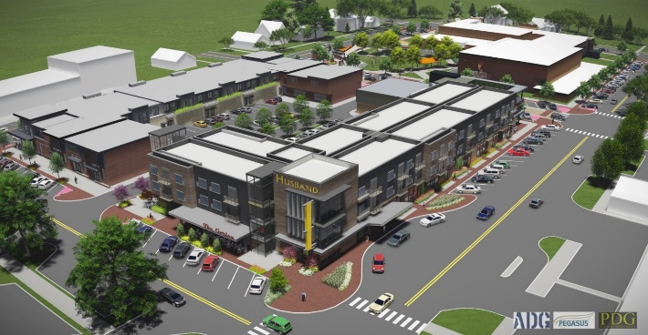
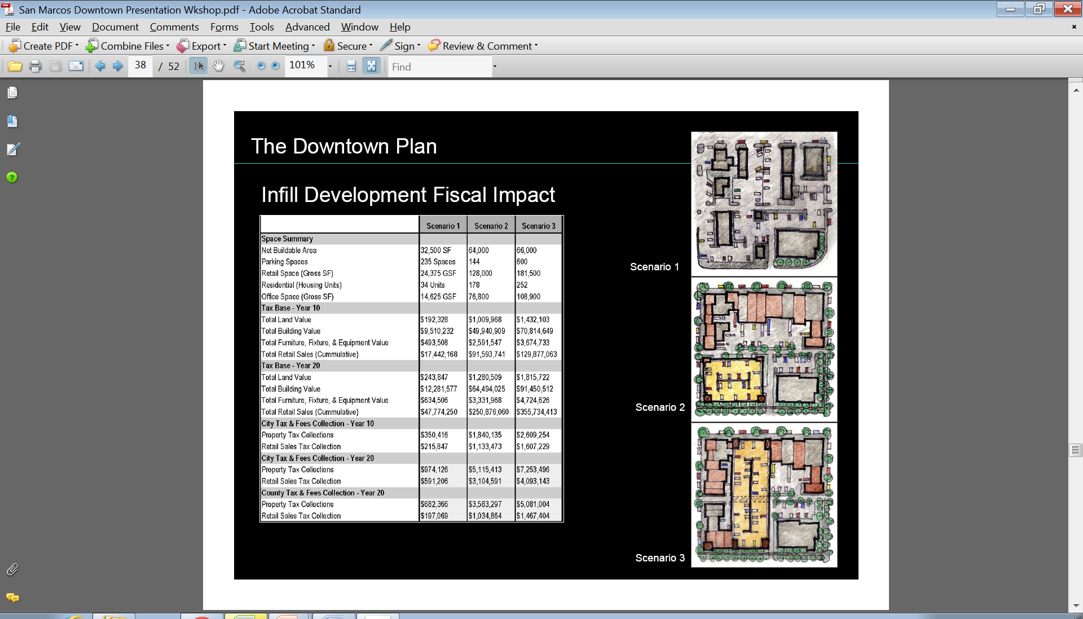
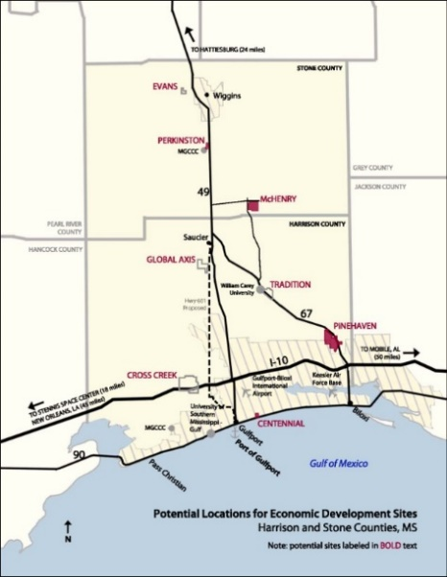
Prior Experience
Redevelopment of 2 Blocks Downtown
Stillwater, OK
Downtown Plan & Revitalization
San Marcos, TX
Economic Development Strategy
Mississippi Gulf Coast, MS

Slide 5
Housing Unit Mix – Aransas County (2016)
 | Estimated & Rounded #s
Total Households | 15,600-16,000
Single Family Units | 10,000-11,000 units
Multi-family Units | 2,170 units
Mobile Homes | 2,300-3,300 units
RVs (1/3 full in off season = utilized as primary residence) | 202 units
Vacation Homes - Percent of total are seasonal, recreational or occasional use | 26%
Note: Estimates from American Community Survey
And Aransas County Appraisal District
The Median Family Income (MFI) for the county is $45,000 (which is high). 35,000/year is roughly 80% MFI, and $20,000/year is 45% MFI.

Slide 6
Low Income Households Stressed
Owners & Renters Spending >30% of their Income on Housing
Low Income Owners (68%)
Income | Households | Total of all Households
Less than $20,000 | 665 | 1085 | 61%
$20,000-$35,000 | 357 | 1514 | 24%
Total | 1022 | 2599 | 39%
Low Income Renters (32%)
Income | Households | Total of all Households
Less than $20,000 | 745 | 789 | 94%
$20,000-$35,000 | 319 | 447 | 71%
Total | 1064 | 1236 | 86%

Slide 7
Housing Damage
% Of Units Damaged by Severity
TOTAL HOUSEHOLDS – 16,000
MOBILE HOMES – 2800 (AVG)
Homes damaged by 50%+
MH damaged by 11-49%
MH damaged by <10%
38%
46%
MH damaged by 50+%

Slide 8
Projecting Housing Needs
There is need at every income level: low-income owners and renters were already both housing stressed
The average value of a home owned by a county-resident was $161,000.
The average value of a home owned by a county resident that was heavily damaged was $185,000.
53% of heavily damaged resident-owned homes were worth more than $100,000; 47% were worth less.
Most of the apartment stock of the city was completely destroyed

Slide 9
Housing Recommendations
Housing Need by Income Level and Own vs Rent
Rent - $500/mo
Own - $60,000
Rent - $875/mo
Own - $168,000

Slide 10
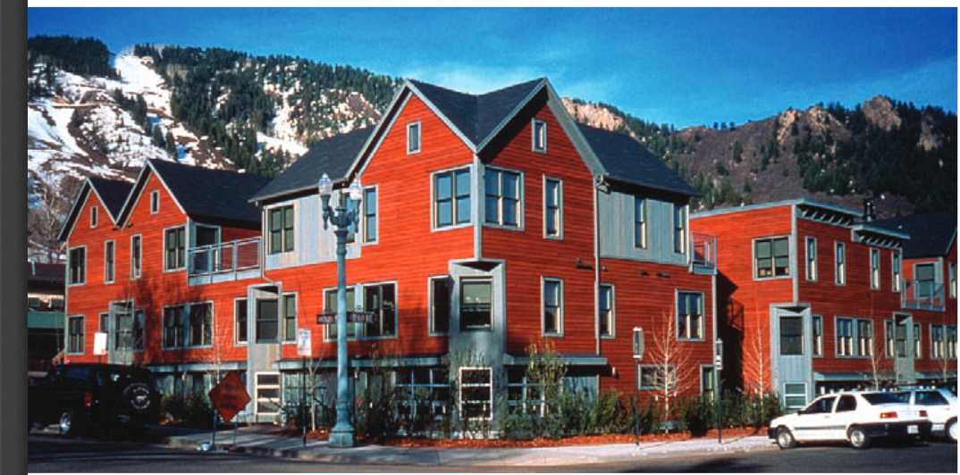
Workforce Housing - defined
Housing that doesn’t cost more than 30% of your income
Leaving 70% for food, transportation, clothing and other necessities
Located in the high-cost community of Aspen, Colorado, Benedict Commons was developed by Jonathan Rose and Jim Curtis working with the city of Aspen to provide affordable housing to workers.

Slide 11
Challenges
Housing Availability
  Very short supply of workforce housing made worse by loss of units
  Short term units (rental & hotel) occupied by contractors and storm victims
  No MF Lease & Repair units; 123 MHUs installed to date
  Approximately 600 apartment units destroyed or are long term rebuilds
Capacity
  No existing Community Development Corp or Housing Agency
  Little existing builder/developer capacity
  Workers have left town
Communication
  How to communicate to relocated workers and to those needing housing
OVERCOMING CHALLENGES KEY TO BRINGING RESIDENTS AND WORKFORCE HOME

Slide 12
Challenges con’t
Land
  Pre and post storm land prices significantly drive up costs
Jobs
  Only 350 of 1300 businesses open; reduced hours of operation due to lack of workers
Floodplain regulations
  50% rule – If a structure is damaged >50%, the entire structure must be brought into floodplain and building code compliance
OVERCOMING CHALLENGES KEY TO BRINGING RESIDENTS AND WORKFORCE HOME

Slide 13
Housing Programs – How Can Partners Help?
 | Repair Existing Rental | Repair Existing Homes | Repair Existing Apts | New Rental 2F-TH | New Homes For Sale | New Apts | UpLift | IA: Down Pmt Mortgage, Counseling
Case Workers | X | X | X | X | X | X | X | X
Private Builders |  |  |  | X | X | X
FEMA/GLO/COG | X |  | X |  |  |  | X
TDHCA | X | X | X | X | X |  |  | X
HUD/CDBG-DR | X | X | X | X | X | X | X | X
SBA |  | X |  |  |  | x |  | X
Rebuild Tx Fund |  |  |  | X | X | X | X | X
USDA |  |  |  | X | X |  |  | X
Nonprofits |  | X |  |  | X |  | X | X
TSAHC |  |  |  | X | X |  |  | X
CBDRG |  | X |  |  |  |  | X | X
Banks - CRA | X | X | X | X | X | X | X | X

Slide 14
Housing Programs – USDA
Program | Type | Applicant | Uses
Single family loans - Section 502 | Direct loans | Families/individuals | Buy, build improve, repair or rehab perm residence
Single Family Loans - Section 502 | Loan guarantees | USDA approved lenders | Purchase new or existing home for perm residence
Single Family Home Repairs - Section 504 | Direct loans and grants | Homeowners, 62 year old+ | Repair or replace: roof, heating, structural repair, water/sewer connect fees etc
Mutual Self-Help Housing -Sect 502 | Direct loans | Families/individuals | Construction of new home by applicant or nonprofit group
Mutual Self-Help Housing - Section 523 | Grants | Non-profits/public bodies | Tech assistance to supervise small groups of families to build each others homes
Multi-Family Rental Housing - Sections 515 | Direct loans | Individuals, non-profit | New construction & rehab of existing multi-famiy
Multi-Family Rental Housing - Section 538 | Loan guarantees | Individuals, partnerships, LLC, state & local agencies | New construction, permanent loan or substantial rehab of multi-familly rental
Housing Preservation Grants - Section 553 | Grants | Public bodies and non-profits | Finances repair and rehab activities for single family and small rental properties
USDA is only ONE example of Housing Programs to help rebuild

Slide 15
Non-Profit Partners in Place to Date
Habitat for Humanity
Mennonites
Rebuilding Together
Samaritan’s Purse
UMCOR
NeighborWorks
Baptist Men
SBP (tbd)
Other partners to come!

Slide 16
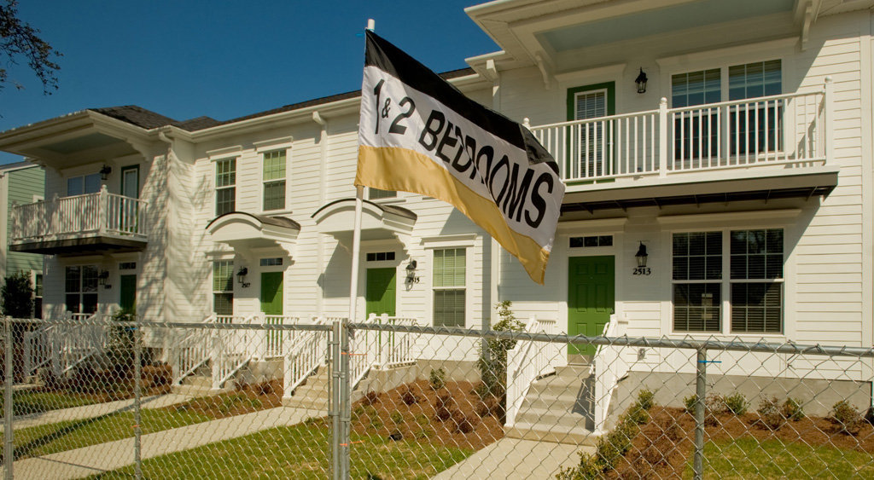
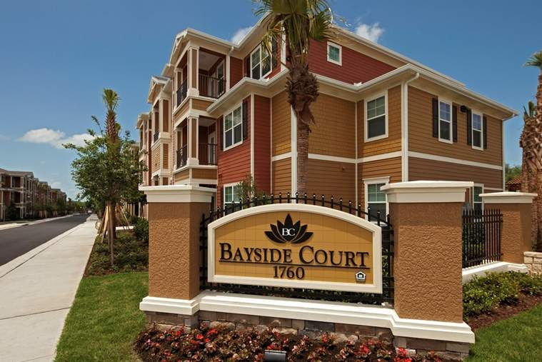
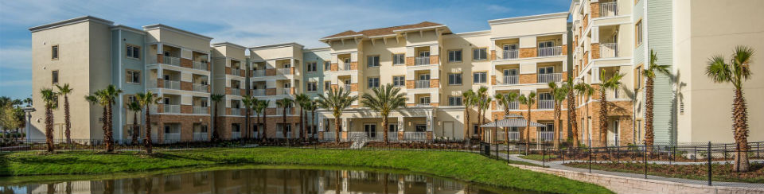
Section 8 Housing that Looks Good

Slide 17
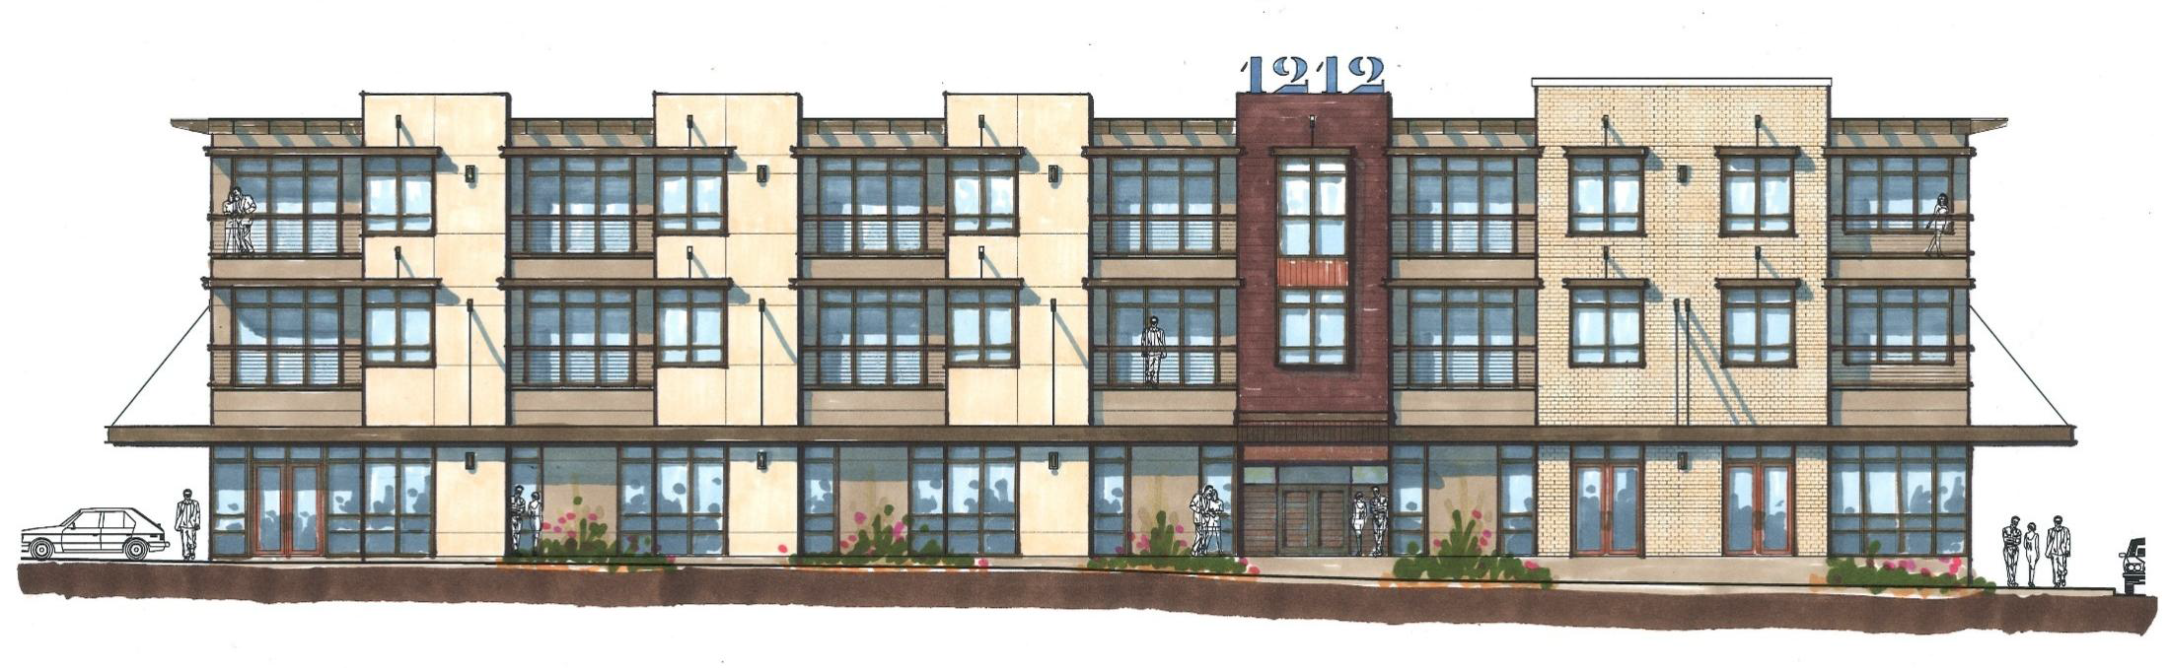

Workforce Housing – paying for it
Rental vs Ownership. Financial Models Different
Speculative development which brings inherent risk on part of lenders and others
Tax Credits, Subsidized or Private/Market
Layering of Finances is good goal, with an eye towards low cost and quality to build.
33-unit mixed-income and mixed-use HOUSING LAND TRUST in Central East Austin.
Sources of funds included: City of Austin GO Housing Bond Funds, HUD 202 Sr Housing
theChicon.com

Slide 18
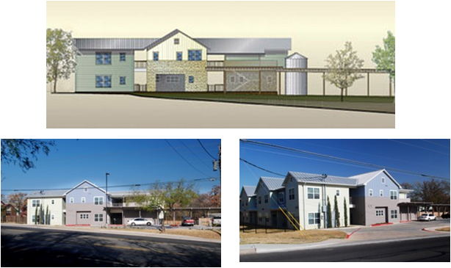
Workforce Housing for Seniors – paying for it
Public-Private Partnerships to reach mutual goals – Provide and Pay for Housing
  Publicly-owned land leveraged for workforce housing
  Federal Loan Guarantees
  Federal Grants
  Federal Loans
  Private Foundation Funds
  Private Developer/Owner
22 Unit Senior Affordable Housing Project in Central East Austin. Funding Sources included: City of Austin GO Housing Bond Funds, HUD 202 Sr Housing

Slide 19
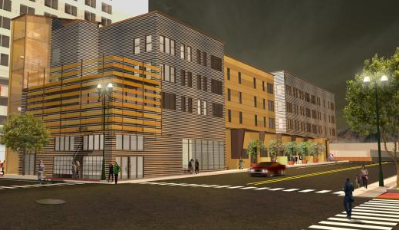
Workforce Housing for Artists
Artspace is a nonprofit real estate developer specializing in creating, owning and operating affordable spaces for artists and creative businesses. Artspace is the nation’s leading developer of arts facilities – live/work housing, artist studios, arts centers, commercial space for arts-friendly businesses and other projects.
The Roderick Artspace Lofts in El Paso, TX blends 51 affordable live/ work units for artists and their families with 5,000 square feet of multi-purpose nonprofit commercial space. A large community room on the ground floor will provide space for artists and community groups for meetings, events, exhibitions and performances.

Slide 20
Inclusionary Zoning
Cities can provide incentives to promote the development of affordable units like streamlining the development process, offering parking reductions, providing tax abatements, reducing development fees, offering cash incentives, or dedicating general obligation bond dollars in exchange for workforce housing units.

Slide 21
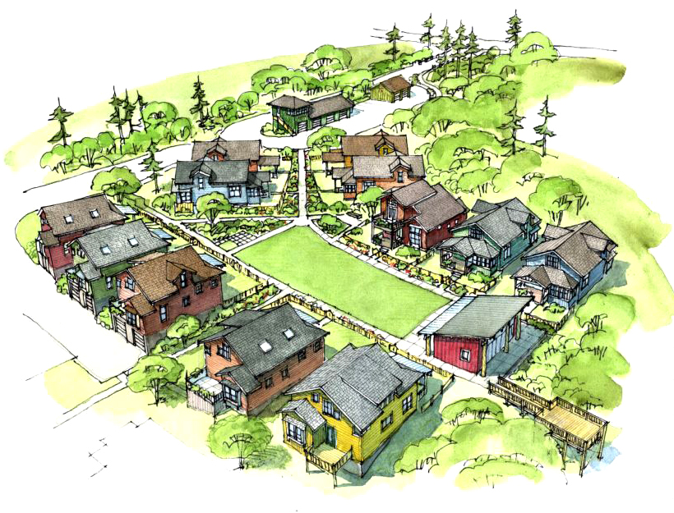
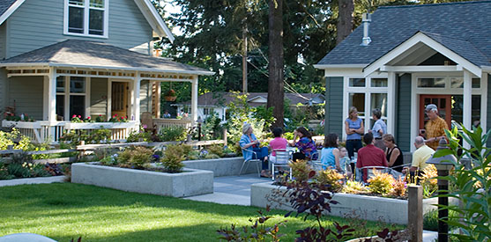
  Clustered Housing Concept
    Clustered Housing
    More dedicated open space and parkland
    Smaller lot sizes
    Smaller setbacks
    More Environmental protection
    More mixed-use
Common spaces
Clusters of 12-14 homes

Slide 22

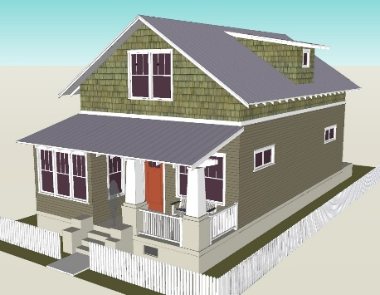
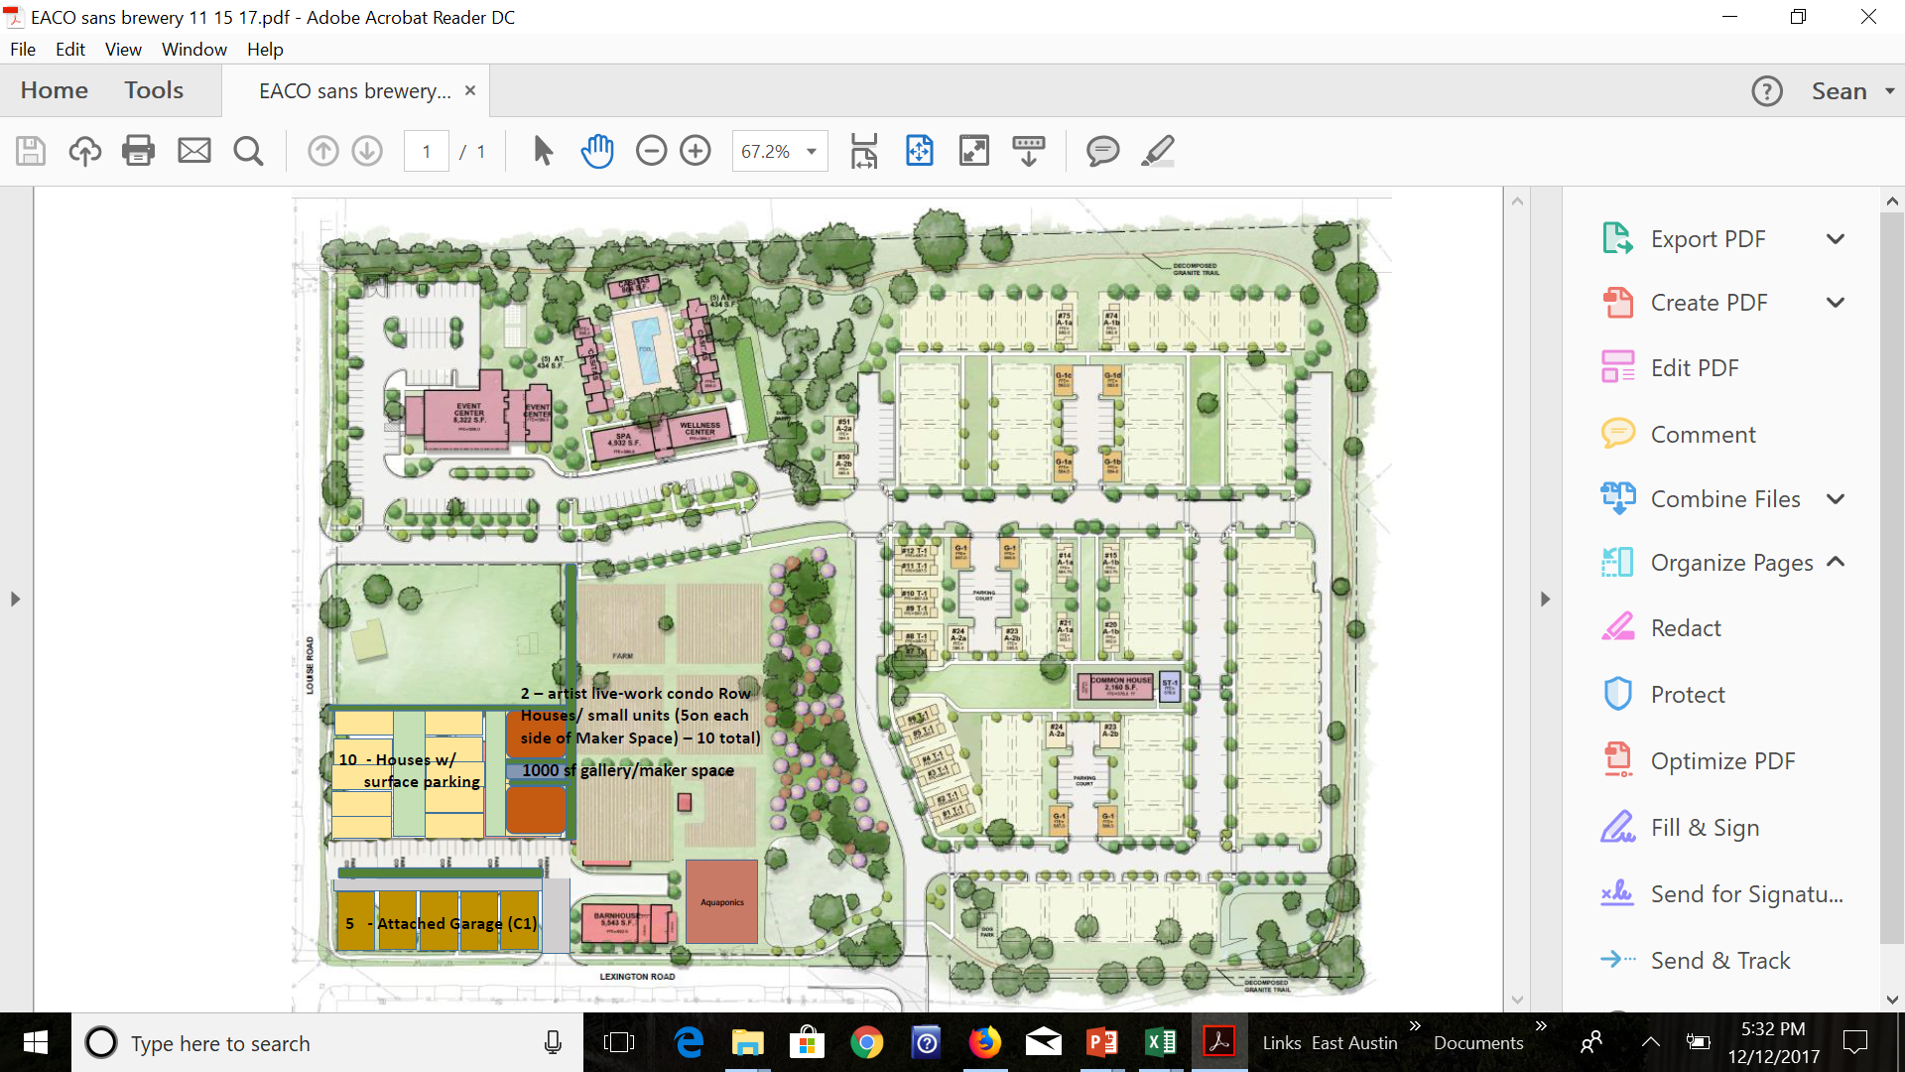

Slide 23
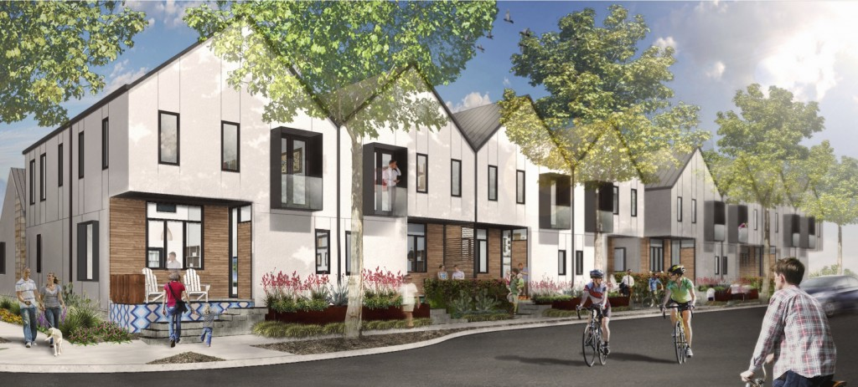
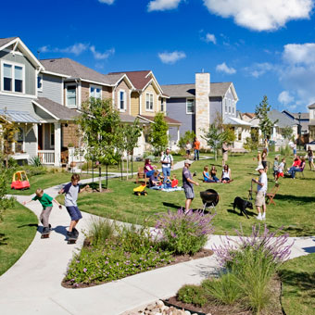
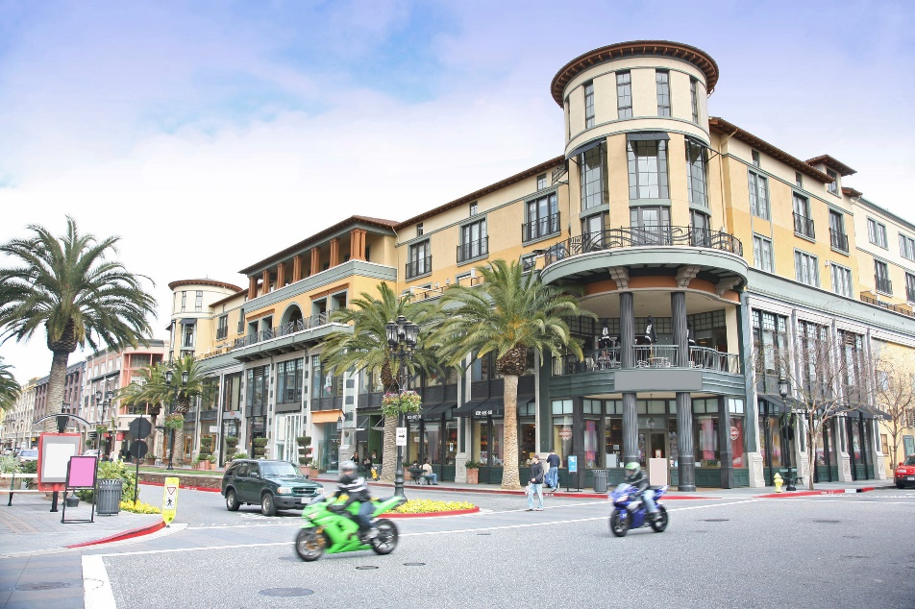
  Denser Mixed-Use, Walkable Development
    Smaller Lots (3,000-5,000 sf ; Current Min Lot Size in Rockport 7500sf)
    More compact
    Walkable

Slide 24
  Downtown Plan

Slide 25
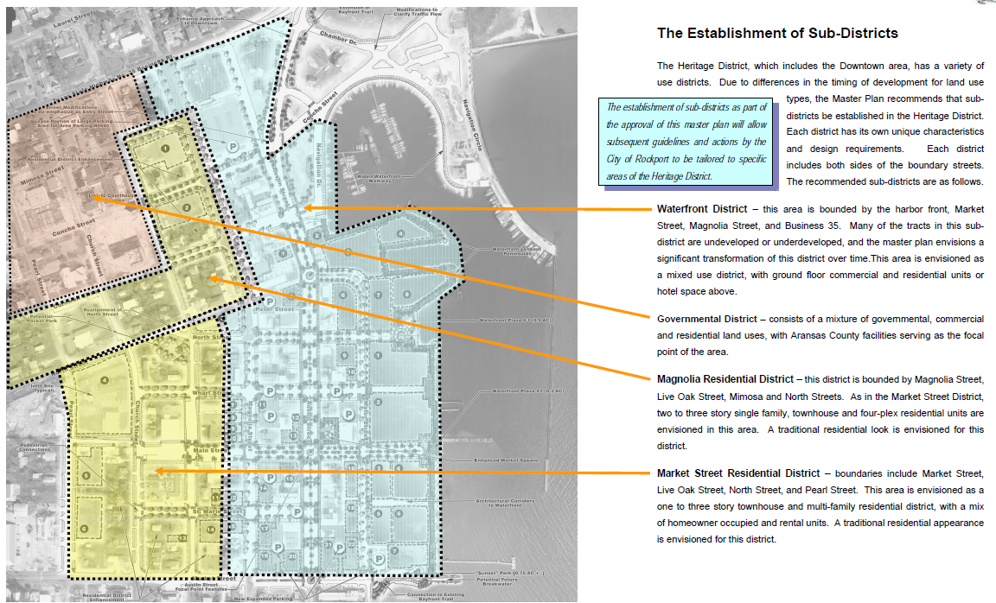
  Downtown Plan

Slide 26
Housing Issues
Housing Solutions
Regulatory
  Inclusionary/exclusionary zoning
  Process time
  Nimbyism
  Comp Plan Update(s) necessary
Site Cost Issues
  Infrastructure Availability
  Impact Fees
  Construction Costs
  Site Feasibility
Financial
  Incentives for Builder/Developer
  Assistance for Homebuyer/Renter
Construction Types
  Innovative Material Usage
  Smaller homes
  Employer-sponsored Workforce Housing
Regulatory
  Fee Waivers
  Fast track permitting
  Plan Amendments to Necessitate Rebuild
  Education to Public
Site Cost Issues
  Site Analysis for Suitability and Infrastructure
  Contracts with Material Providers (Home Depot, Others)
  Analysis of Impact to City with Fee Waivers (perhaps need Federal Assistance here)
Financial
  Local and Federal Banks, with Programs
  Who will be GUARANTOR??? Fed Loan Guarantees
  Homebuyer/Renter Financial Education
  Employer-Sponsored Housing
Construction Types
  More compact developments
  Smaller Homes
  Manufacturing Facility in Rockport for SIPs (Job creator)

Slide 27
Key Questions - Housing
What type of housing do you want to see built in Aransas County ?
What changes in how housing regulations do you want to see?

Slide 28
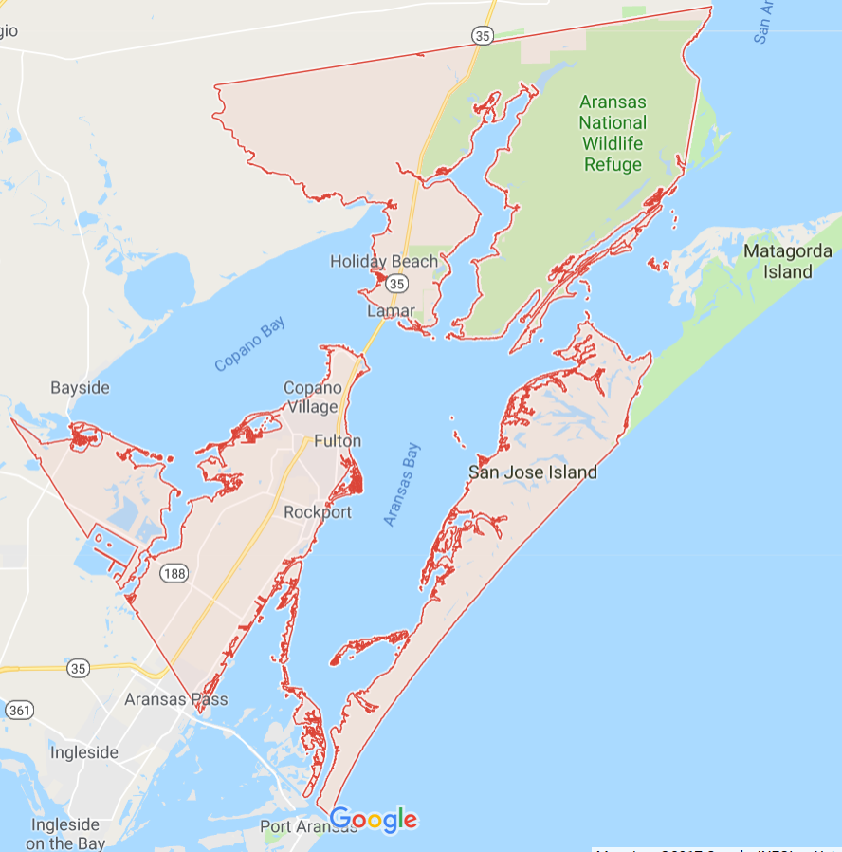
Key Questions - Housing
Where do you want to see new housing Construction?
    In Downtown
    Near Airport
    Near Treatment Plant
    Holiday Beach
    City/County

Slide 29
Next Steps
Pegasus to prepare Housing Strategy by mid-January
Continue to be a part of the SOLUTION
Help Recovery Team with Communications to dislocated workers

Slide 30
HOUSING RECOVERY PLAN
FOR
ARANSAS COUNTY, TEXAS
Community and Business Workshops
December 13-16, 2017
Facilitator - Sean Garretson, AICP
Pegasus Planning and Development

Slide 31
Where Are Children Living?
38 or 1%
52 or 2%
2665 total students enrolled
  200 of the 2665 will likely return to Catholic School
  Enrollment is down 700 students or 28%*
Studies show displaced children want to go home, even if the conditions are not ideal
Note “Doubling up”…
Not sustainable
*not including Catholic School students

Slide 32
Bridging the Gap between
Income and Housing Costs
Housing Type | Market Rent / Price | Target Affordable Rent / Price
Rental Apartments | 1BR 2BR 3BR older $650 $700 NA older $925 $1019 $1110 newer | Eff 1BR 2BR 3BR $636 $745 $856 $1175
Rental Duplexes/ Townhomes | 2BR 3BR older $700 NA older $1019 $1110 newer | $750- $1236
For Sale | $200 psf (newer) $151-$170 psf (older) $200,000 for 1,000 s.f. (newer) | $115-135 psf (new) $135,000 for 1,000 s.f.

Slide 33
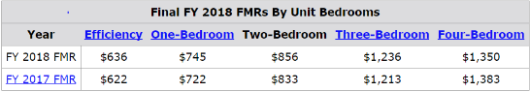
Market Rents & Values
Median Pre-storm Home Value | $253,000*
Median 2 bedroom rent | $1132**
Owners & Renters Spending >30% of their Income on Housing | 30%
% of Low Income – Renters | 32%
% of Low Income - Owners | 68%
HUD Fair Market Rent
*Texas A&M Real Estate Center
**Zillow

Slide 34
Housing Goals – Initial Estimates
Repair/rebuild 3,150 single family units
  Reflects units with 50% or more damage done including MHUs
Repair/rebuild 565 multifamily units
Add 200-300 units of affordable housing
  Enough to house 10% of low income ($35,000/year) households
Where feasible, replace units with duplexes, triplexes, quadplexes to facilitate affordability
Engage & partner with residents, public, private sectors, non-profits

Slide 35
Current Process
Direct Housing
MF Lease & Repair
COG
Case
Managers
Small Repair Program
<
Housing recipient finds housing on their own; possibly in Aransas County or somewhere else
FEMA Assigns Direct Housing Option to Recipient
Disconnect
Communicate & facilitate housing options
PREP Repair Program
<
MHUs & Trailers
CBDRG*
Case
Managers
SBA Loans -Owner Repair
*Coastal Bend Disaster Recovery Group

Slide 36
Strategy: Key Considerations for Moving Forward
Connect the Dots
Coordination of COG/GLO caseworkers and Coastal Bend Disaster Recovery Group caseworkers
Caseworkers match a home option with the recipient and pre-sign a lease or purchase agreement
Address privacy issues
Do it Fast
Construction timeline that meets demand to seamlessly move recipients from Short Term to Long Term Housing
If we don’t, we won’t retain workforce… employees are portable
Keep it simple
Complexity discourages partnerships, slows the process, and adds bureaucracy
Raise capacity
Private, public, and nonprofit partners
Leverage partner funding/incentives
Multi-faceted approach
MEETING THE NEED WHEN IT IS NEEDED

Slide 37
Strategy: Key Considerations for Moving Forward
Focus on Sustainable Housing
Better quality than pre-Harvey
Attract workforce back to the community
Mixture of rental and ownership
Meet wind/hurricane code requirements
Green building, accessible
Contextually appropriate
Management Plan for maintenance, capital investment, crime free
Accomplish Affordability
Mix of rental unit types that meet affordability requirements
All new For Sale units must be affordable
Use incentives to reduce costs
Engage the community
Embrace local input for Housing Plan and approach
Bottom up, not top down approach through public forums, focus groups
MEETING THE NEED WHEN IT IS NEEDED

Slide 38
Pilot Program
Proposed Seamless Process & Programs –
Non-Profit/VOAD Repair Program
UpLift Program- Meet BFE
Rockport Rising -Neighborhood Makeover Program
Grants
Non-Profit/ VOAD New Build Program
Alt Construction Methods
Demolitions before Rebuild
Grants
Direct Housing
CBDRG Case Managers work w/ Recipients for M/LT Housing
MF Lease & Repair
Builder Incentive Programs
-Rental*
Alt. Construction Methods to Expedite (modular)
Public land for Dev. City/County/TXDOT
FEMA Assigns Direct Housing Option to Recipient
Small Repair Program
Tax Incentives / Accel. depreciation
Construction Loans:
-Low Interest interim
-Low Int. permanent
-Line of Credit
-Loan Guarantees
Land Trust
PREP Repair Program
COG Case Managers work w/ Recipients for M/LT Housing
Builder Incentive Programs-For Sale*
Infrastructure Grants
Unit Buy-Down Grants
TIF - Homestead Preservation District
MHUs & Trailers
Waiver of Fees
Down payment Assistance
Owner SBA Loan Repair Program
Individual Recipient Programs
Individual Mortgage Program
Credit Counseling
Rental Assistance
*Affordability restrictions apply

Slide 39
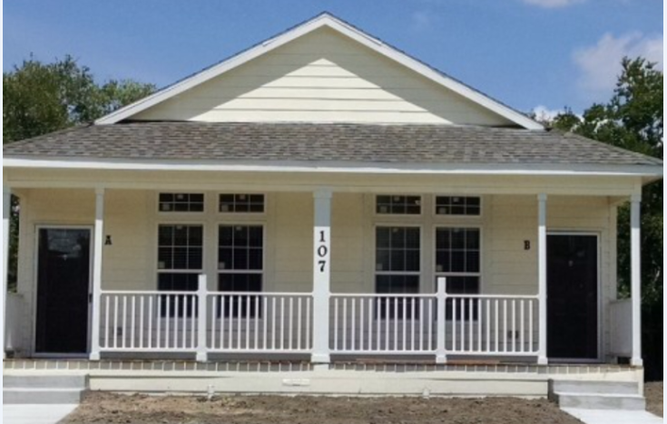
Housing Pilot Program
Multi-Faceted Approach – One Size Does Not Fit All
Non-profit Repair & Uplift
Non-Profit New Build
Builder Incentive – Rental
Builder Incentive – For Sale
Individual Recipient
  LET’S THINK BIG TOGETHER!!

Slide 40
Means To Our Goals
Opportunities for Innovation
Alternative construction methods (modular)
Preposition developer agreements
Preposition other partner agreements
Community Land Trusts
Extreme Neighborhood Makeovers
Homestead Preservation District
Tax Increment Financing
Utilize public land for new development
(city, county, TXDOT)
Traditional But Important Approaches
Construction Loans
  Low interest interim, permanent,
  Line of Credit
  Guarantees
Unit Buy-Down Grants
Tax incentives – accelerated depreciation
(pending legislative changes)
Infrastructure Grants
Waiver of Fees
Uplift Grants

Slide 41
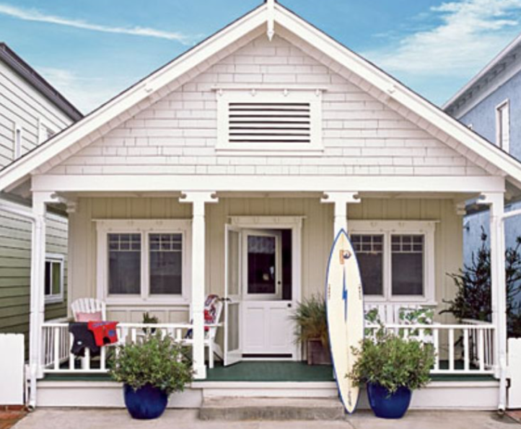
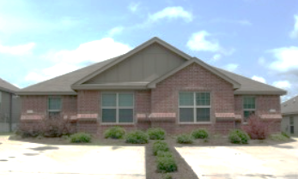
Individual Recipient Programs
  Down Payment Assistance
  Mortgage Assistance
  Credit Counseling
  Rental Assistance

Slide 42
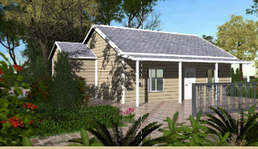
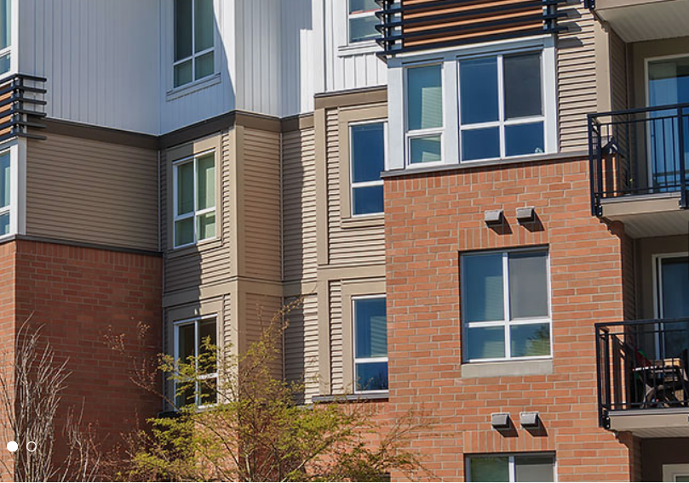
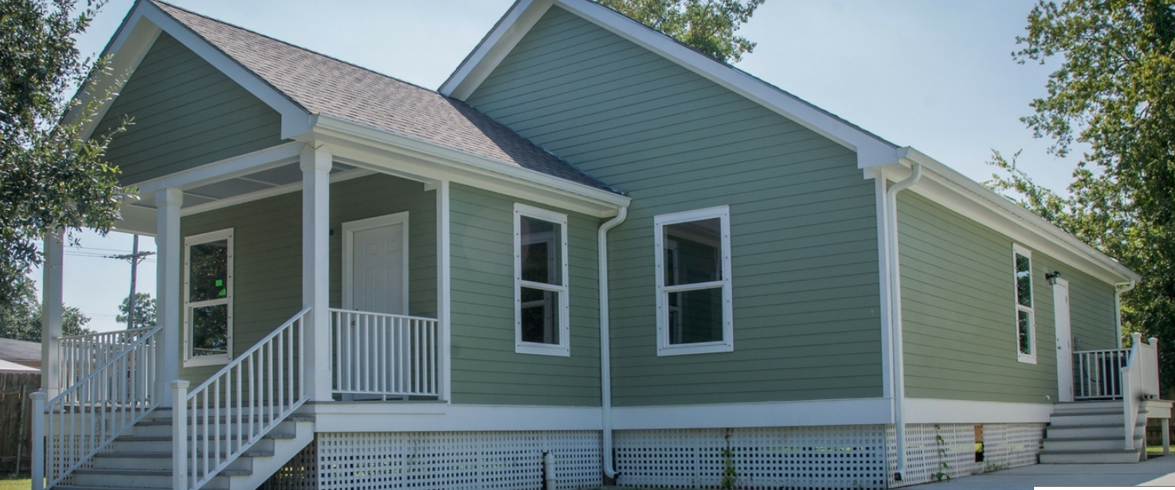
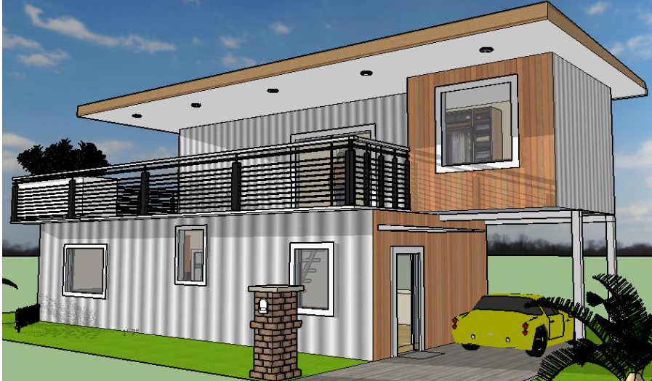
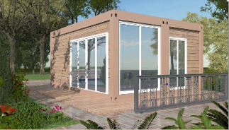
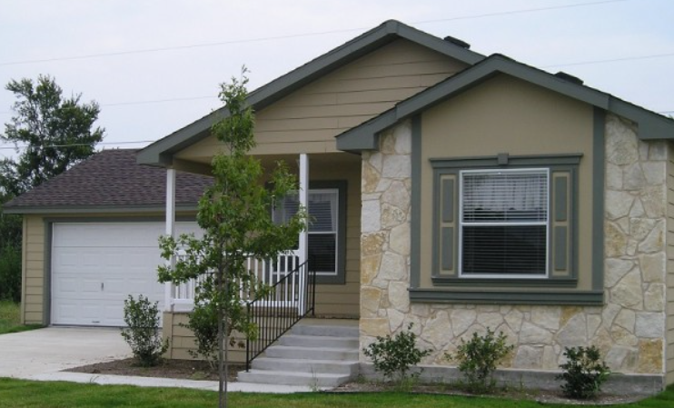
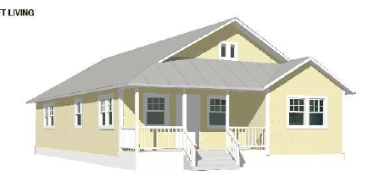
Utilizing Alternative Construction Methods

Slide 43
Request #1 of Feds/State: Housing
Assistance to Refine and Establish Programs Now
  Finalize non-profit relationships & agreements
  Finalize developer RFP process & agreements
  Set up incentive programs
  Finalize funding request and commitments
Redesign coordinated case worker system that matches and facilitates housing options (including new), providing a seamless transition for program recipients

