Slide 1
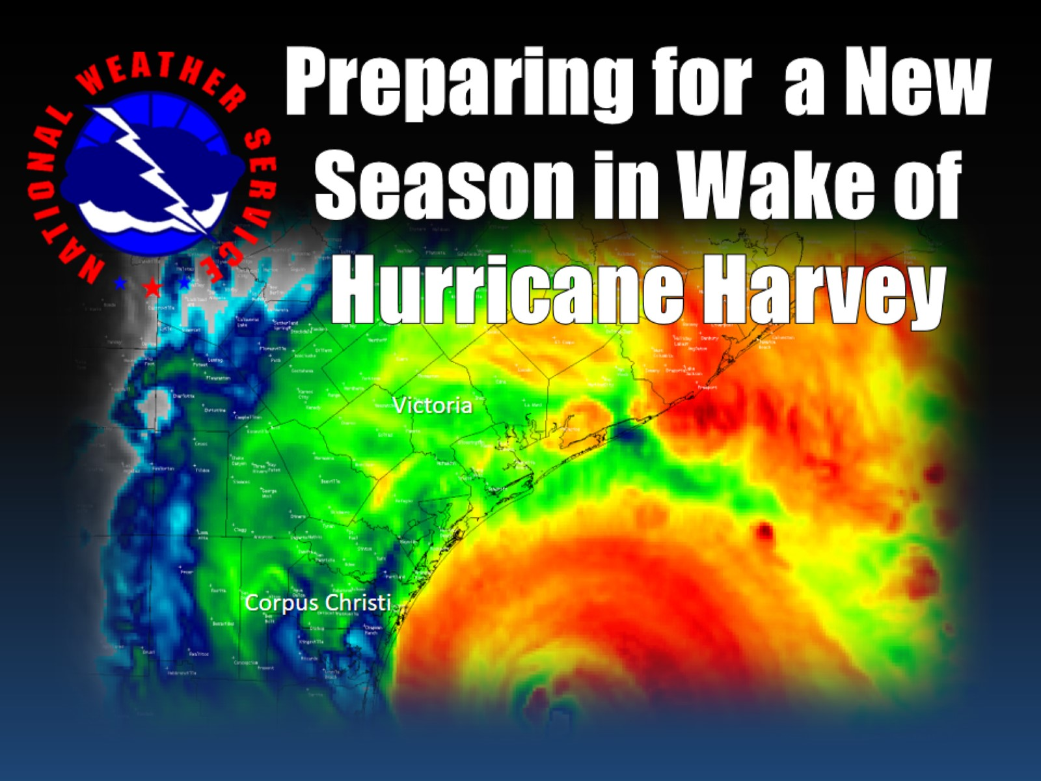

Slide 2
Harvey Losses

Slide 3
Harvey Debris

Slide 4
AEP’s Herculean Effort

Slide 5
Mindset Before Harvey

Slide 6
Mindset before Harvey

Slide 7
Complacency

Slide 8
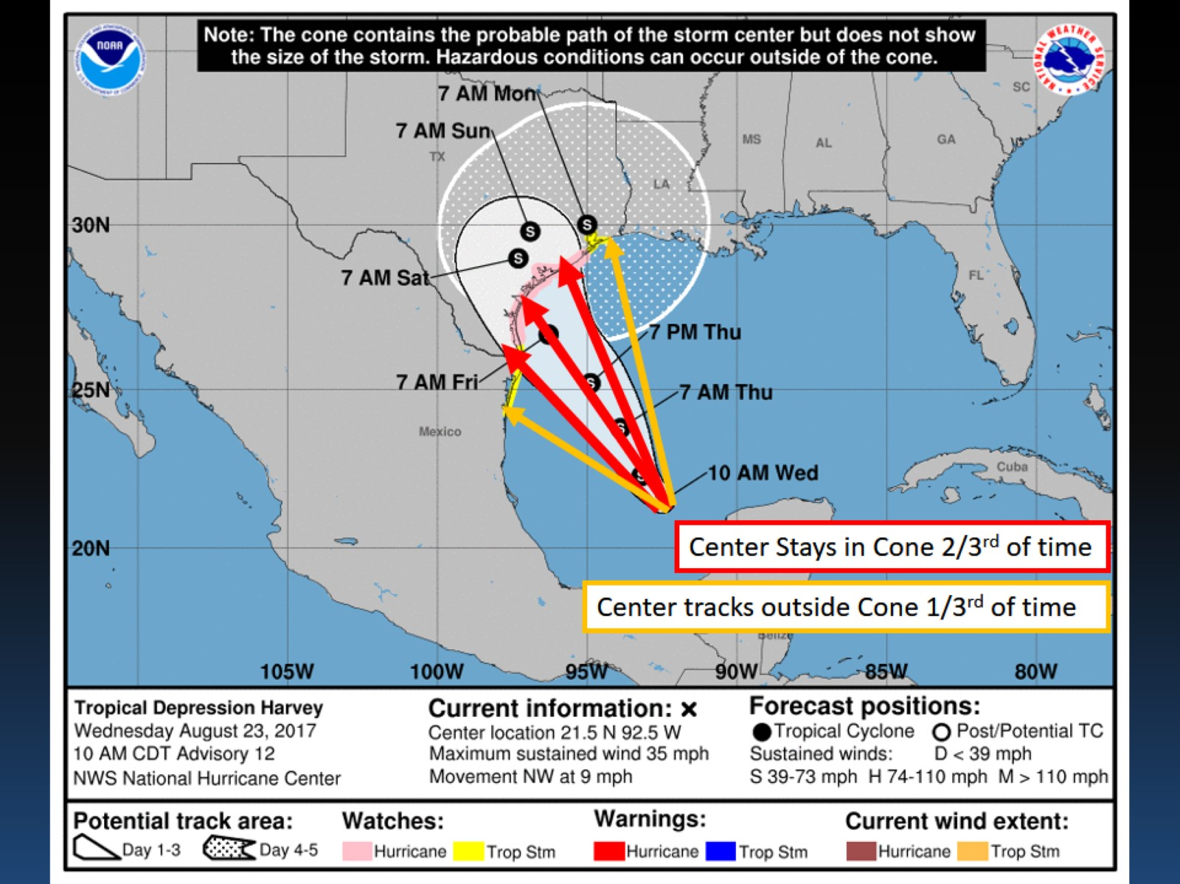

Slide 9
Medium-Range Ensemble Guidance from 00Z Tuesday, 22 August 2017

Slide 10
Genesis of Hurricane Harvey

Slide 11
Inside Hurricane Harvey

Slide 12
Saffir-Simpson Hurricane Wind Scale

Slide 15
Hurricane Warning

Slide 16
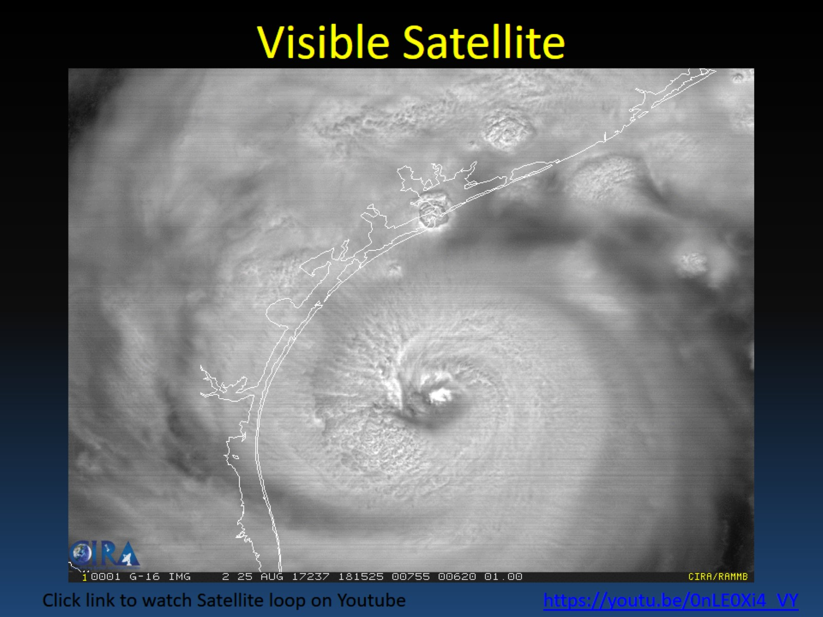

Slide 17
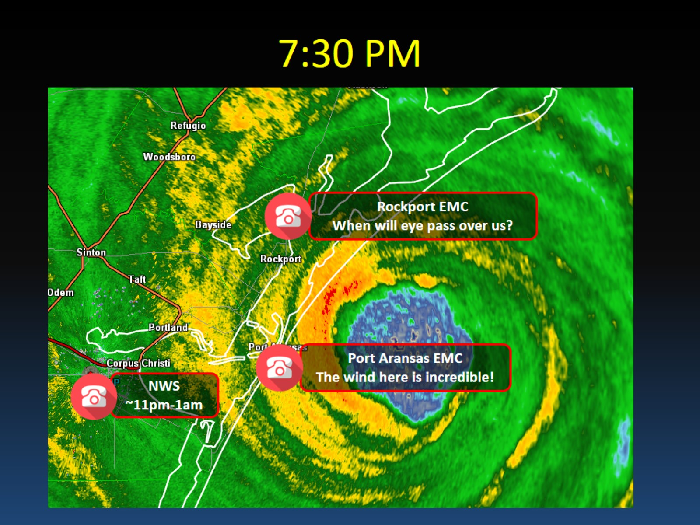
7:30 PM

Slide 18
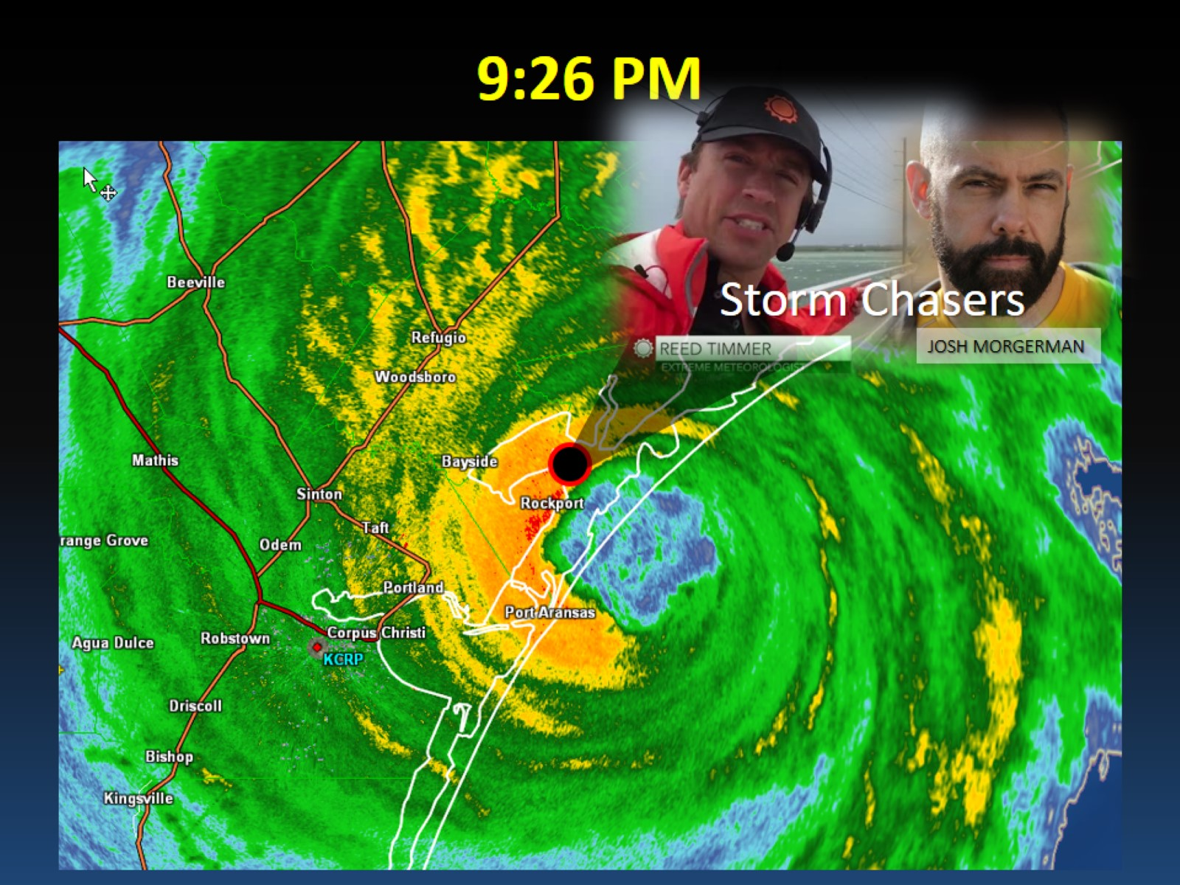
9:26 PM

Slide 19
Rockport, TX

Slide 20
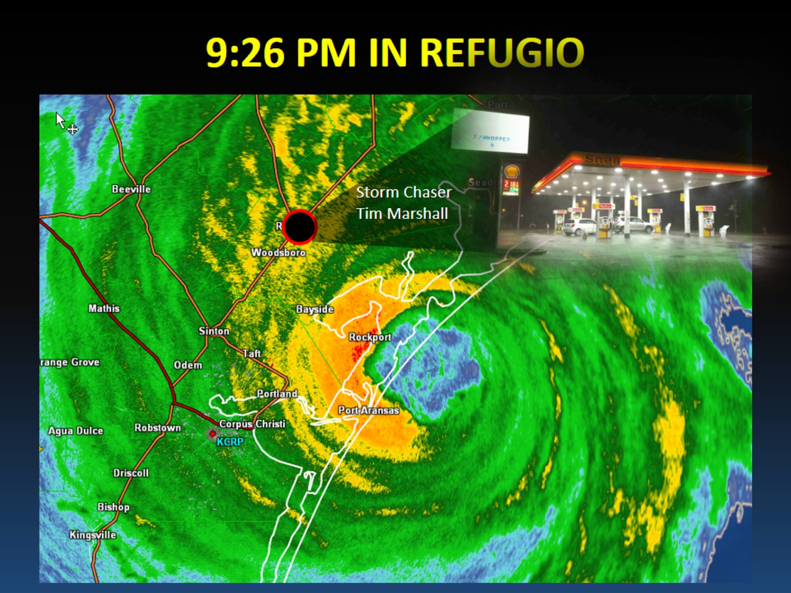
9:26 PM IN REFUGIO

Slide 21
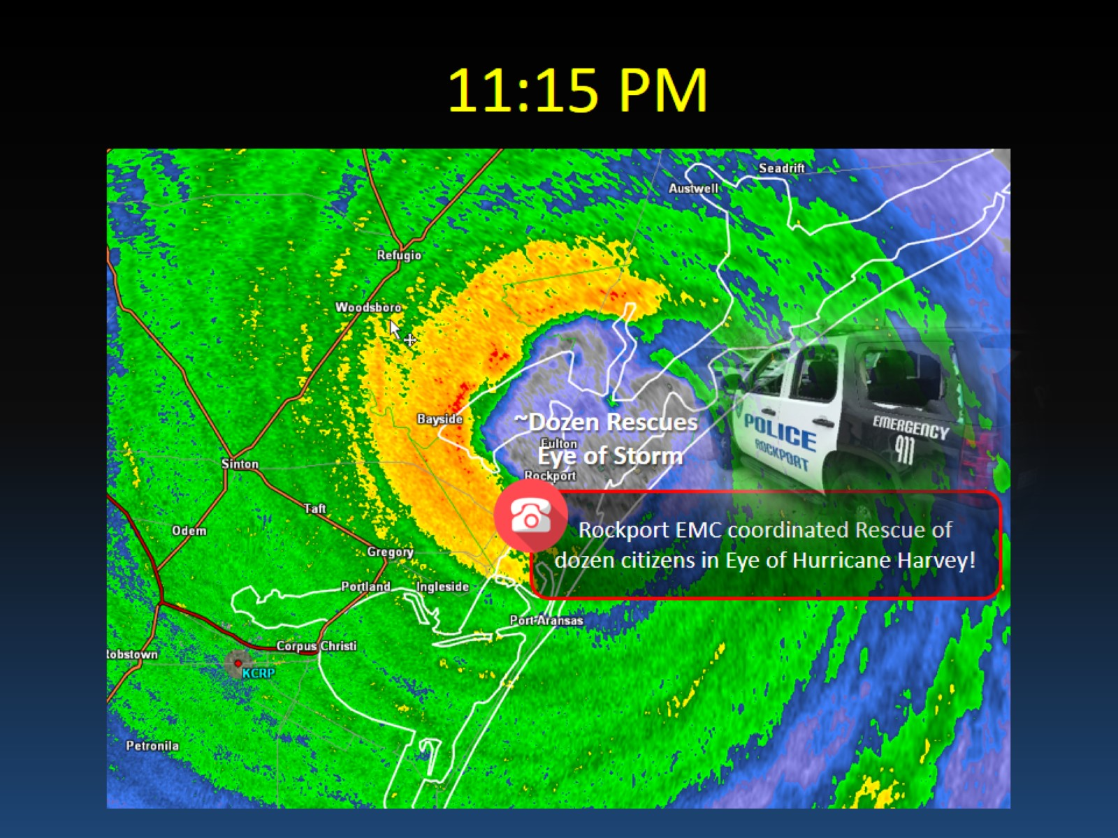
11:15 PM

Slide 22
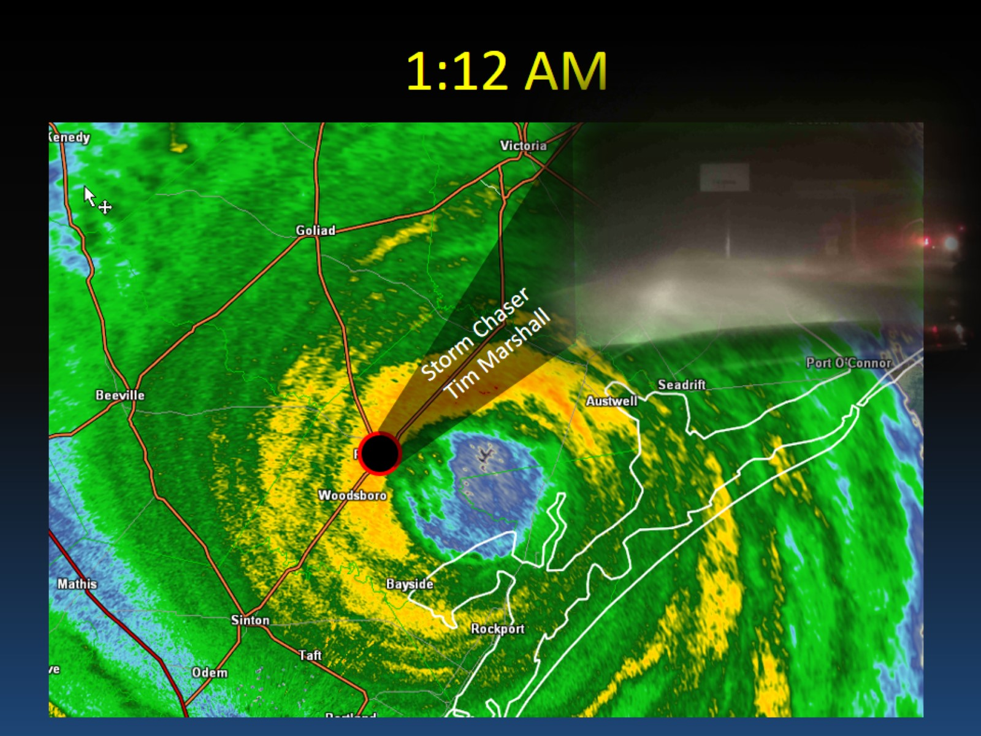

Slide 23
Harvey Makes Landfall

Slide 24
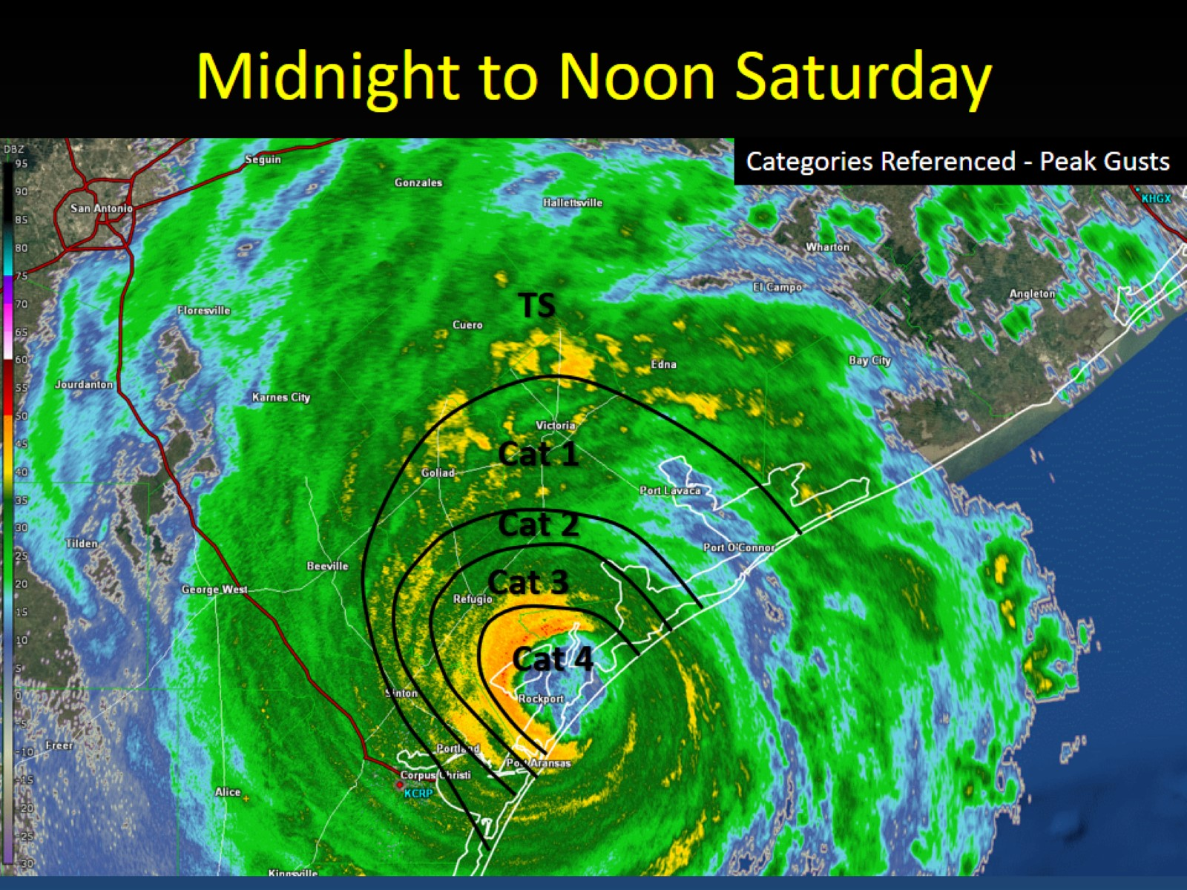
Midnight to Noon Saturday

Slide 25
University of Florida in Rockport

Slide 26
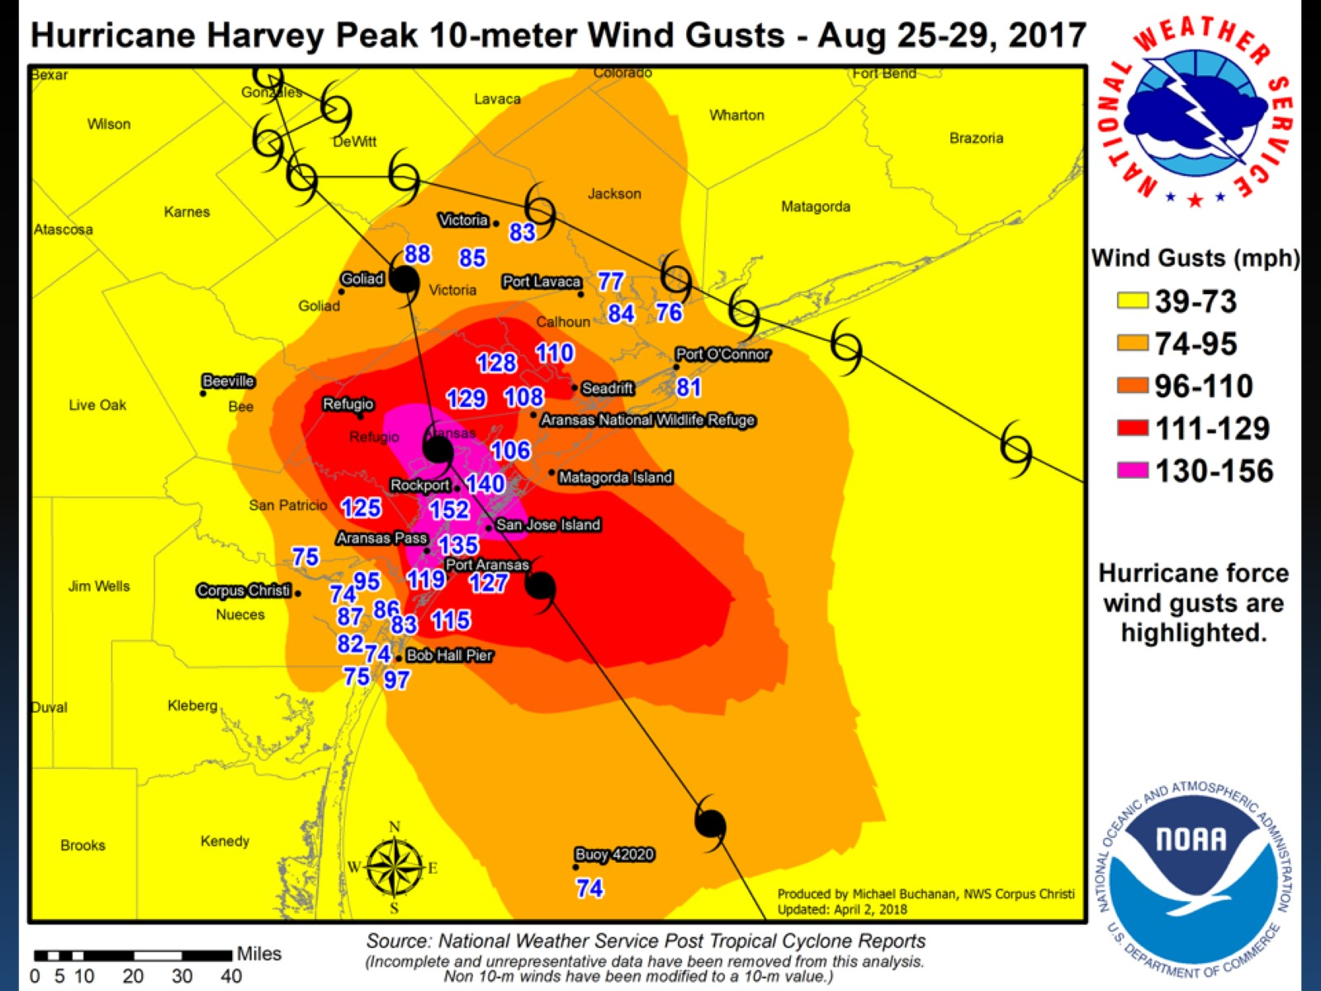

Slide 27
Wind Damage in Victoria

Slide 28
Wind Damage in Victoria

Slide 29
Wind Damage in Bloomington

Slide 30
Damage in Calhoun County

Slide 31
Refugio Co

Slide 32
Lamar, TX

Slide 33
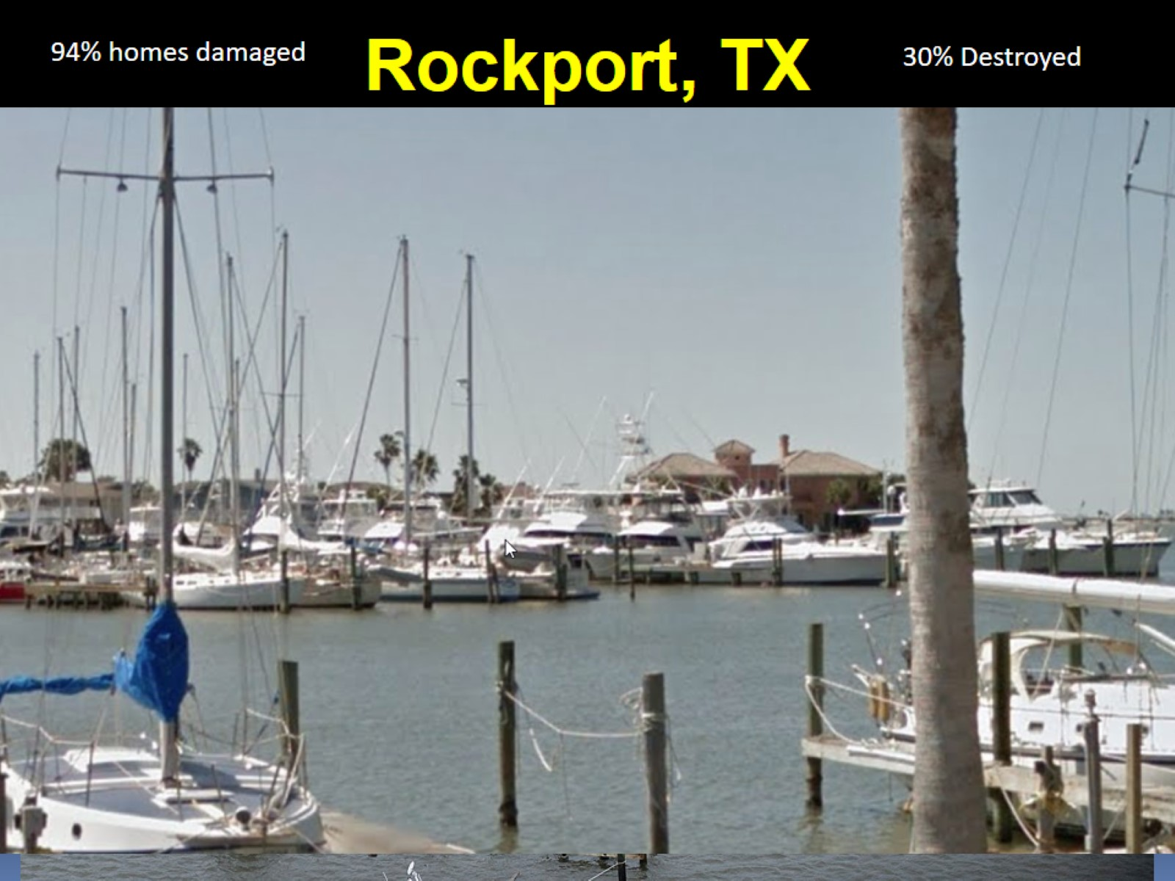
Rockport, TX

Slide 34
Aransas County, TX

Slide 35
Rockport, TX

Slide 36
Copano Ridge

Slide 37
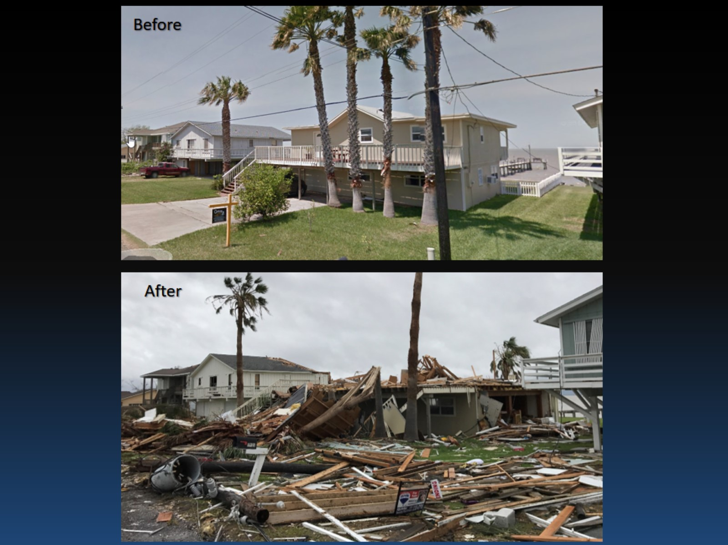

Slide 38
San Patricio County

Slide 39
Aransas Pass

Slide 41
Port Aransas Ship Channel

Slide 43
Storm Surge

Slide 44
Storm Surge/Storm Tide

Slide 46
Storm Surge Maps

Slide 47
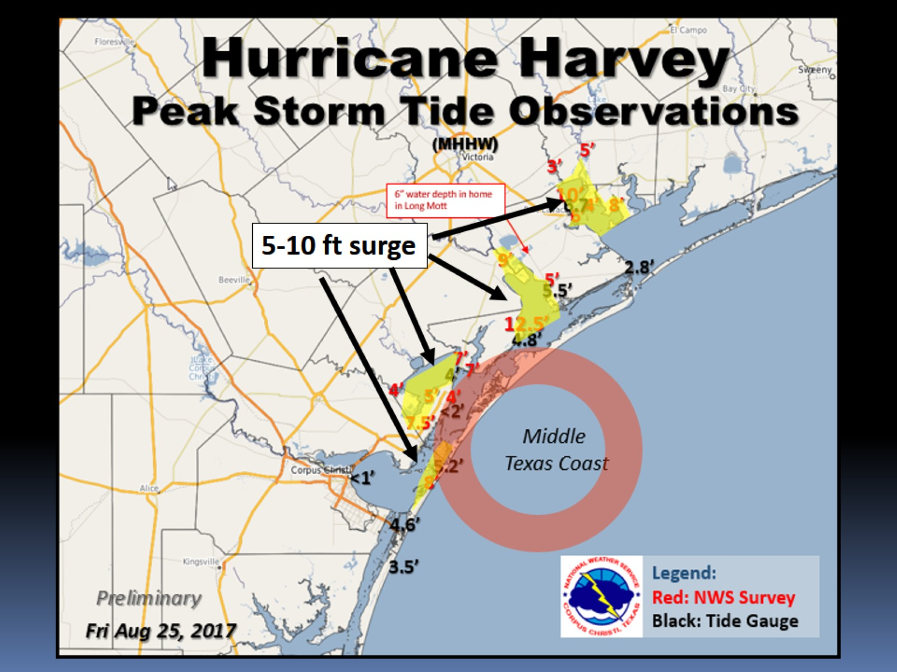

Slide 48
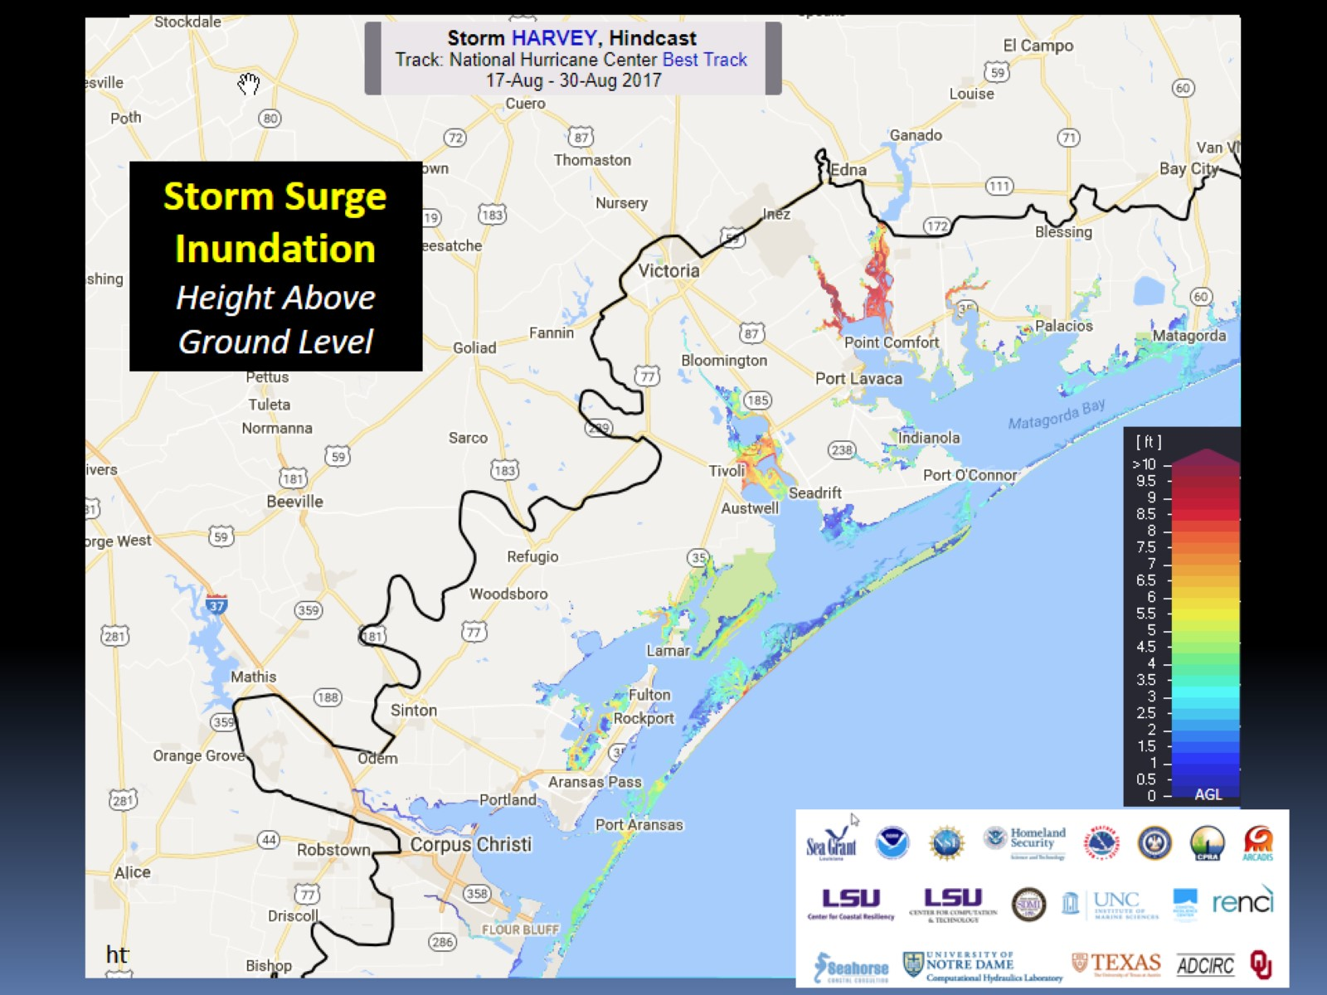

Slide 49
Victoria Barge Canal

Slide 51
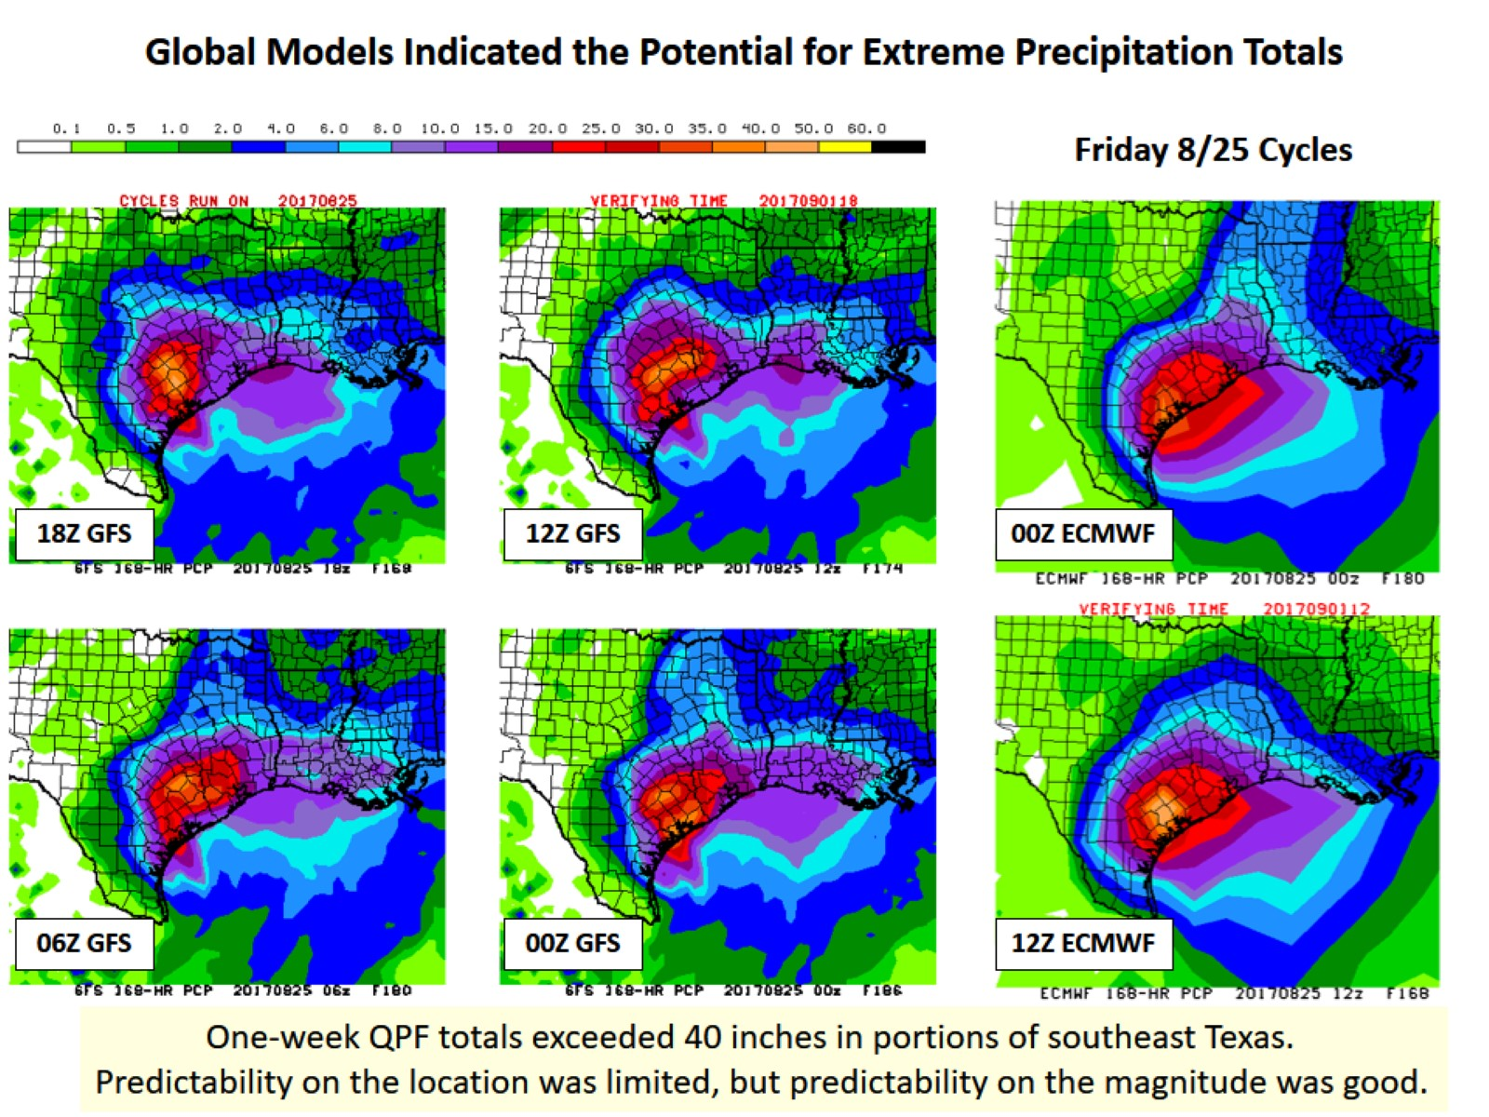

Slide 52
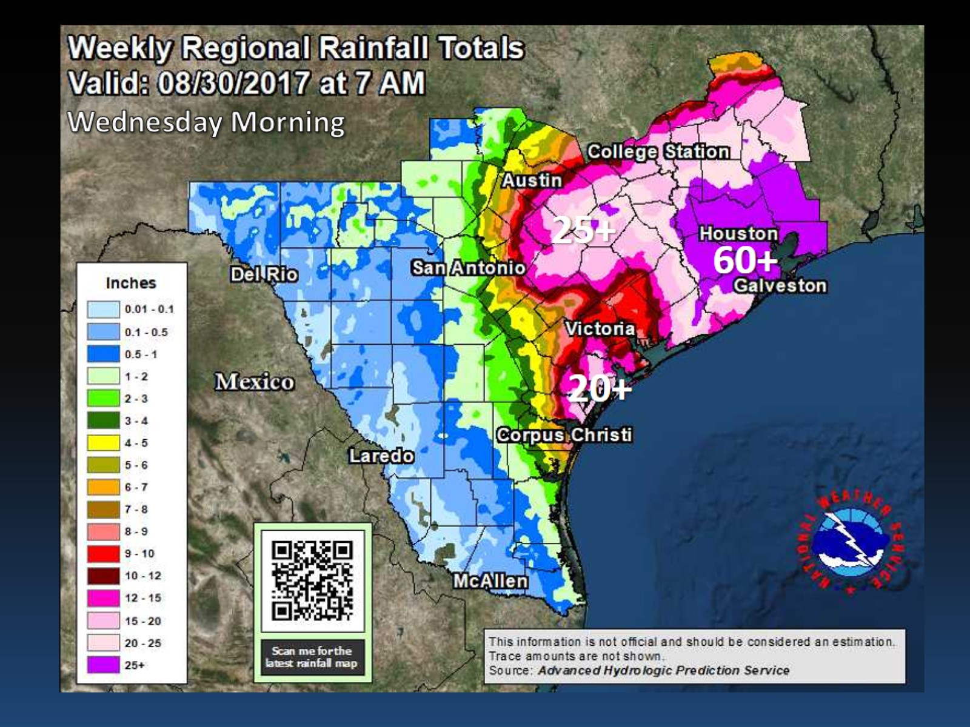

Slide 53
Hurricane Harvey 2017

Slide 54
290,000 structures flooded

Slide 55
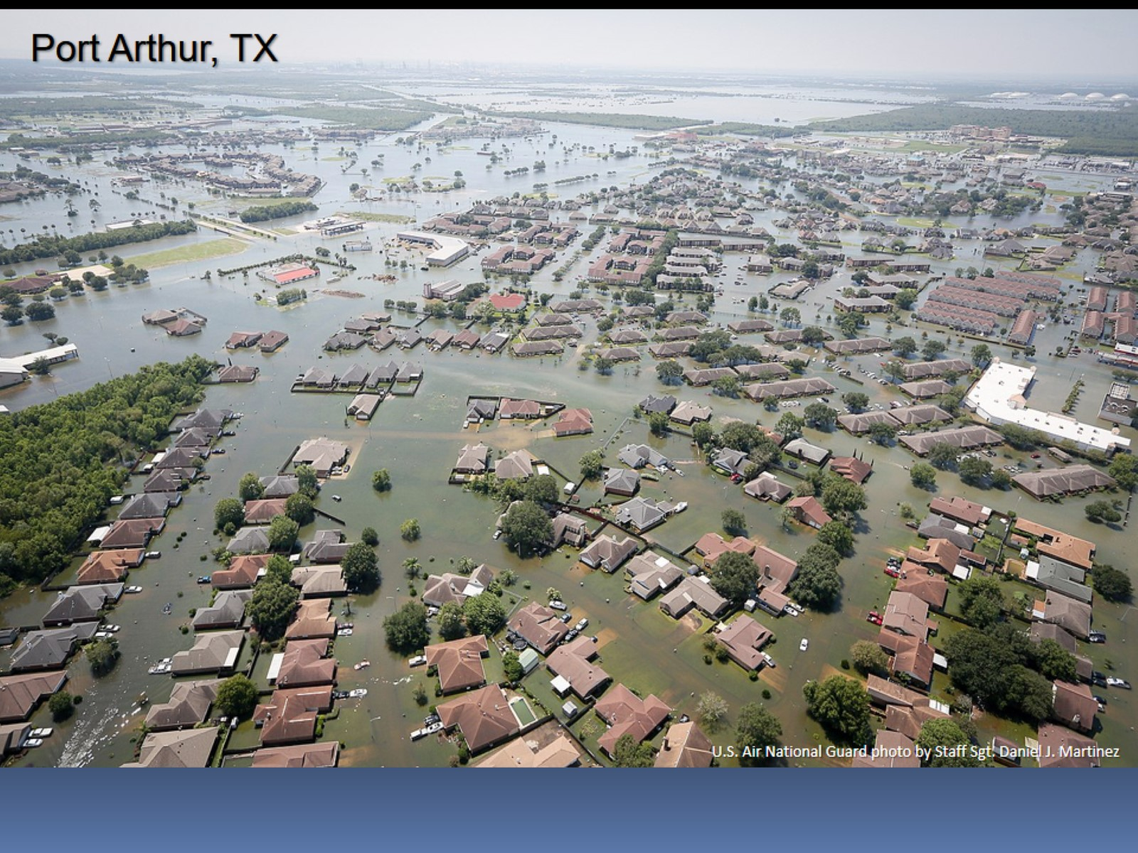

Slide 56
2 cm is estimate how much Houston sank into the Earth under weight of water from Harvey

Slide 58
Texas World Speedway

Slide 59
Hurricane Season

Slide 60
How do you stay informed

Slide 61
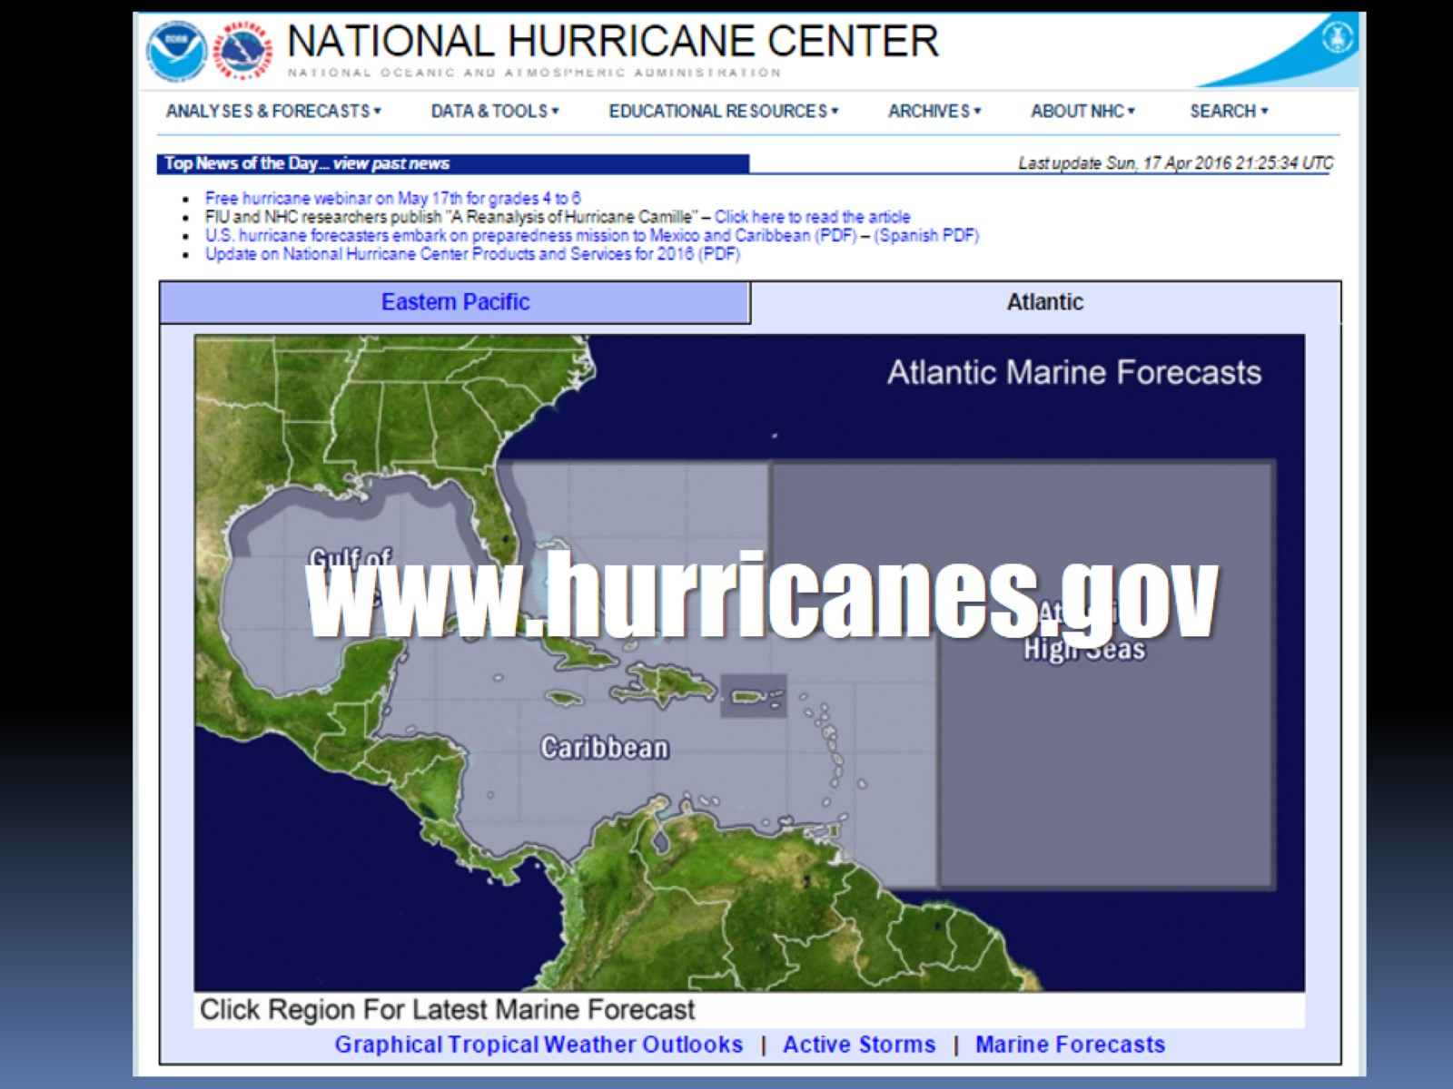

Slide 67
Tropical Weather Outlook

Slide 68
Watch –vs- Warning

Slide 70
Preparing for Wind

Slide 71
Building Codes Work!

Slide 72
Importance of Proper Roof Installation!

Slide 73
Preparing For Floods

Slide 74
Preparing for Tornadoes

Slide 75
Insurance Tips

Slide 76
Evacuation

Slide 77
Outlook for 2018 Season?

Slide 78
Normal Season

Slide 79
Past Hurricanes

Slide 80
Past Hurricanes

Slide 81
Past Hurricanes

