Slide 1
Email Marketing The Right Way
Rockport-Fulton Chamber of Commerce
July 10, 2018
Dr. Karen A. Loveland

Slide 2
Email Marketing is Dead?
People send and receive 281 billion emails per day; increasing to 333 billion by 2023.
85% of adults send or read email; 99% check email every day.
72% of consumers prefer to receive promotional messages through email.
Customers who receive email marketing spend 83% more; place 44% larger orders; order 28% more frequently.
Average return on email marketing investment is over $40 per dollar spent.
73% of marketers report email marketing is a “core strategy”.
59% of marketers plan to increase email budget in 2018.
Email is Alive and Well!!

Slide 3
Inbound Marketing
HUGE disconnect between how companies sell and how customers buy!
Traditional Marketing – finding customers by putting your message in front of as many people as possible. Less effective and more expensive.
  CAN-SPAM Act - $16,000 fine for each email sent in violation!
Inbound Marketing – empowering people by providing helpful, relevant content that provides value.
Start a conversation to pull people in rather than interrupting them.

Slide 4
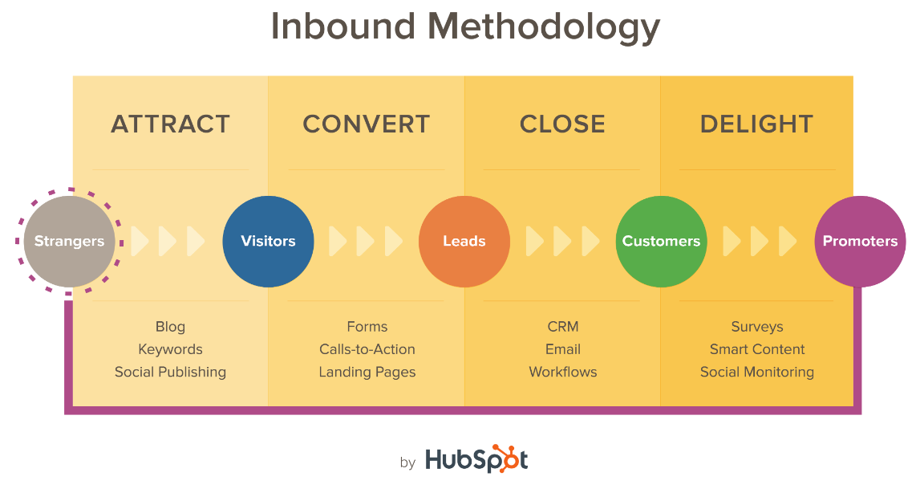
Using Email in the Customer Lifecycle

Slide 5
Building Your Email List
Do NOT Buy Email Lists – EVER!
Create a Free Opt-In Offer on Your Website
  Consultation, product or service info, ebook or email series, coupons & sales promotions, loyalty/rewards programs, contests/sweepstakes, exclusive information (e.g., sneak peak or bonus content)
Add Subscription Link to Employees’ Email Signature
Encourage Subscribers to Share and Forward Your Emails
Be CAN-SPAM Compliant – include unsubscribe link in all emails, remove people who unsubscribe, include physical address in email signatures.

Slide 6
Segmenting Your List
Lifecycle stage (subscriber, lead, MQL, SQL, customer, advocate)
Demographics (gender, age, location, job title, or buyer persona)
Behavior (shopping cart abandoners, browsers)
Buying frequency & amount
Source of lead (store signup, loyalty program, newsletter subscriber)

Slide 7
4 Types of Emails
Newsletters – sent regularly to subscribers to provide news/updates
Lead Nurturing – sent in response to behaviors to convert leads to customers
Informational – similar to newsletter but usually sent to larger groups. Often event/time specific.
Transactional – triggered automatically (welcome, confirmation, follow-up)

Slide 8
Components of High Performing Email
INCREASE EMAIL OPENS
Familiar “From” Name
  Use Company Email NOT Free Webmail
  Audience Expectations
  23 Characters
  Don’t use No-Reply Address
Short, Relevant Subject Line
  30 Characters
  No “Salesy” Language or Gimmicks (e.g., “Re:”)
Compelling Pre-header Text
CONVINCE READER TO ACT
Simple Body Copy
  One Goal (Newsletter exception)
  Minimal images w/ Clear ALT Text
  Write for Scanning
  Match Tone to Buyer Persona
  Personalize
  Proofread, Proofread, Proofread
Clear Call to Action (CTA)
  Use Button (minimum 44 pixel square)
  Don’t Use “Click Here”; Tie to Nature of Action

Slide 9
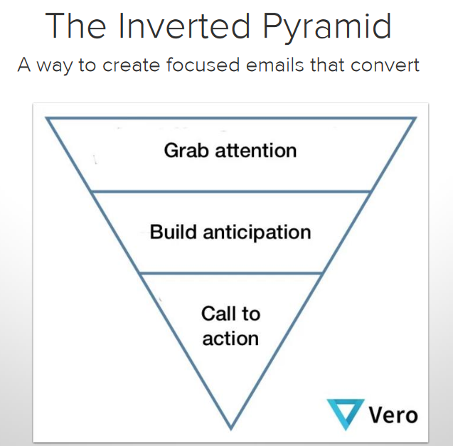
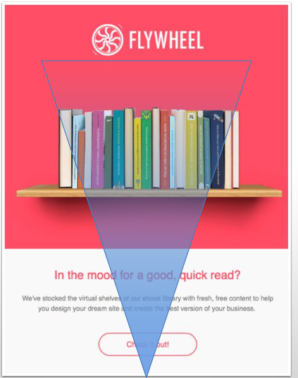
Email Design & Functionality

Slide 10
Email Deliverability
  Before the Send Review
    Source – All reputable email services FORBID purchased/rented lists. DON’T SPAM!
    Permission – Did they opt-in to receiving email from you?
    Expectations – Did they expect to receive this type of email from you?
  After the Send Review
    The Good -- Engagement metrics – open rate, click-through rate, replies, call volume, website traffic
    The Bad -- unsubscribes – you didn’t meet their needs. Opportunity to learn.
    The Ugly – Bounces & Spam Complaints
  Reasons for Bounces
    Recipient (Hard) Bounces - Stop sending, address isn’t valid
    Content – blocked by mail service for questionable links, not enough text content, spelling errors, or similarity to messages marked as spam. Work on content.
    Reputation Bounces – your company, IP address, ESP, or any URL in your message. Long-term death sentence.
    Temporary (Soft) Bounces – may be traffic or may indicate content or reputation issues developing.

Slide 11
Email Analytics
Open Rate = (# emails opened/# emails delivered) * 100
  Use to test content & format variations; compare to previous campaigns
Clickthrough Rate (CTR) = (# clicks/# emails delivered) * 100
  Measure of engagement; useful for testing alternative formats/CTAs
Conversion Rate = (# of completed CTAs/# emails delivered) * 100
  Are you achieving your goals?
Bounce Rate = (# bounced emails/# emails sent) * 100
  Should be less than 1%. Higher indicates issue with contact list maintenance.

Slide 12
“Best” Email Marketing Service for Small Businesses & Nonprofits
Mail Chimp (www.mailchimp.com)
  Easy to use
  Autoresponders
  Contact segmentation
  Geolocation and sending time controls
  Tracking and analytics
  Paid plans start at $10/month once you grow.
Bring your laptop/tablet and join me next month to learn how to get started with Mail Chimp!

Slide 13
Thank you for your time!
Any Questions?
karen.loveland@tamucc.edu

