Slide 1
Minimization to Sufficiency Initiative
And Next Steps
Scott Jones, Esq
Reid Brown, Oregon
2025 NOHVCC Workshop

Slide 2

Minimization to Sufficiency Initiative
Roadmap to the future of motorized recreation on public lands using new statutory tools and existing resources to address shortfalls in access
Adapt to changing landscape and management models
Lots of inaction – we made the first step

Slide 3

Minimization to Sufficiency Initiative
New Tools
Legacy Roads and Trails Act of 2021
Explore Act of 2024
MABA Executive Order
Existing tools
TAP/TAR
State Roadless Rules
Proper Application of National Trails System Act

Slide 4

Minimization to Sufficiency Initiative
1. Make America Beautiful Again Executive Order issued July 3, 2025
MABA EO Initially recognizes
Years of mismanagement, regulatory overreach, and neglect of routine maintenance require action. Land-use restrictions have stripped hunters, fishers, hikers, and outdoorsmen of access to public lands that belong to them. These bureaucratic restrictions have undermined outdoor traditions and threatened conservation funding.

Slide 5
Minimization to Sufficiency Initiative
1. Make America Beautiful Again Executive Order issued July 3, 2025
Initially recognizes
Sec. 2. General Policies. All Federal land management agencies, as defined by 16 U.S.C. 6801(3), shall, to the extent practicable, ensure that their policies:
(a) promote responsible stewardship of natural resources while driving economic growth;
(b) expand access to public lands and waters for recreation, hunting, and fishing;
(c) encourage responsible, voluntary conservation efforts;
(d) cut bureaucratic delays that hinder effective environmental management; and

Slide 6


Minimization to Sufficiency Initiative
1. Make America Beautiful Again Executive Order issued July 3, 2025
Requires
Sec. 4. Conserving Our National Treasures. The Commission shall advise and assist the President regarding how best to responsibly conserve America’s national treasures and natural resources, including by:
(e) developing policies to expand access to public lands, national parks, national forests, and wildlife refuges while promoting a wide range of outdoor recreation opportunities like hunting, fishing, hiking, biking, skiing, climbing, boating, off-roading, and wildlife viewing.

Slide 7
Minimization to Sufficiency Initiative
1. Make America Beautiful Again Executive Order issued July 3, 2025
Years of mismanagement? Decades is more accurate
Forest Roads and Trails Act of 1964 (16 USC §532)
  Passed 6 weeks after Wilderness Act
  Requires Adequate Roads
  Requires Adequate Trails
  Specifically identifies the need for access to drive economics
EO 11644
  Signed By President Richard Nixon in 1972 and updated by Carter in 1978
  Arguably requires open, closed and designated routes
  Entirely focused on minimization for management goal no mention of adequacy or other values minimization criteria must be balanced with

Slide 8

Minimization to Sufficiency Initiative
1. Make America Beautiful Again Executive Order issued July 3, 2025
What does minimization even mean?
BLM issues a memo on January 17, 2025 that is 113 pages long as a result of West Mojave litigation in California
User Groups – Wilderness Society guidance in 50 plus pages
Answer a lot of delay and even more litigation

Slide 9

Minimization to Sufficiency Initiative
Make America Beautiful Again Executive Order issued July 3, 2025
2005 USFS Travel Management Rule
Addresses minimization of impacts 31 times
Adequacy is only raised 4 times in addressing funding situation
Indication of a lack of balance in planning? Probably
Conflicts with 16 USC 532? Probably
Mismanagement? Maybe

Slide 10
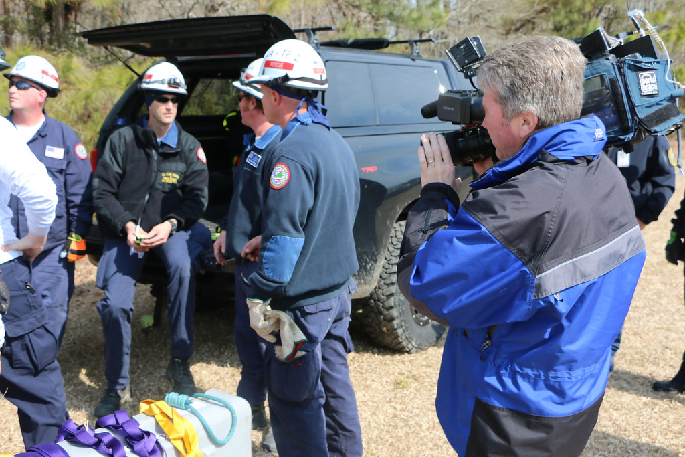
Minimization to Sufficiency Initiative
3. Legacy Roads and Trails of 2021 (16 USC 538a)
  Congress reaffirms adequate roads and adequate trails for public access – not adequate roads or trails
  Requires applicable unit as measure of performance on access issues -
  Adds criteria like emergency response and firefighting as values in planning
  Requires adequacy for future use
  Requires balance with possible impacts from use
  Requires plan is financially sustainable

Slide 11
Minimization to Sufficiency Initiative
Legacy Roads and Trails of 2021
Quality economic analysis continues to be a priority – 2016 Rec Act requires BEA to provide detailed economic analysis of recreational economics

Slide 12
Minimization to Sufficiency Initiative
Legacy Roads and Trails of 2021
Economics
In 2022, the USFWS economic analysis clearly identified that 63% of fishing, 45% of hunting and 51% of wildlife watching spending directly resulted from buying and using motorized equipment in these pursuits.
U.S. Department of the Interior, U.S. Fish and Wildlife Service, 2022 National Survey of Fishing, Hunting, and Wildlife-Associated Recreation Pg 49.

Slide 13

Minimization to Sufficiency Initiative
Explore Act of 2024
  Carried Congressional concerns around a lack of access to public lands further
    Extensive new inventory requirements
      We submitted a detailed list of factors we would like to see inventoried
    Specifically addressed exceptionally short seasonal closures as an issue to be addressed
    Lots of new data requirements – some of which we have
    Generally encourages more motorized and non motorized access to public lands

Slide 14

Minimization to Sufficiency Initiative
Next steps
Implement requirements of Explore Act and Legacy Roads and Trails
Update 2005 TMR- removing it will not make the issues go away
  Presumption that minimization has been completed after more than 50 years of effort
Clarify National Roadless Rule
Use existing tools – TAP/TAR and road to trail conversions
Ongoing challenges
  Large Timber Sales

Slide 15
Minimization to Sufficiency Initiative
Next steps
Use existing tools – TAP/TAR and road to trail conversions
36 CFR 212.5 (b)(2)
Specifically requires road to trail conversions as a management tool
Predates 2005 TMR
PSI & Shoshone NF first we are aware of doing this at any scale
Specifically required by Legacy Roads and Trails Act

Slide 16
Minimization to Sufficiency Initiative
Next steps
Use existing tools – TAP/TAR and road to trail conversions
36 CFR 212.5 (b)(2)
Specifically requires road to trail conversions as a management tool
Predates 2005 TMR
PSI & Shoshone NF first we are aware of doing this at any scale

Slide 17
Minimization to Sufficiency Initiative

Slide 18
Minimization to Sufficiency Initiative
Use existing tools – TAP/TAR and road to trail conversions
  Do this on existing administrative routes
  Part of large timber sales
    Need a no net loss mentality and oversight of process
    National Roadless Rule – parallel for BLM
    Separate Inventory from decision making
    Apply State Wilderness Acts accurately in the planning process
    ESA reform

Slide 19

Minimization to Sufficiency Initiative
Aligning with Agency Efforts
Good Neighbor Authority under Explore Act
Agency retains administrative Control and State Assumes greater operational control
  State By State Umbrella agreements addressing issues they agree to
  Then more detailed Forest/FO level agreements
  Recreation is addressed at varying level
  Idaho
  Montana
  Colorado
  Pikes Peak only

Slide 20

Minimization to Sufficiency Initiative
Aligning with Agency Efforts
  Recommendations
  Determine if your state is engaged in this type of effort
  Unsure how many forests are doing this?
  Are you doing the work?
  If you are doing the work, you need to be engaged
  How well is recreation engaged in the State Agency that is taking the lead?
  Funding?
  OHV grants are generally protected for moto
  Match Funds
  Federal block grants

Slide 21

Questions
Roadless?
WSA?
Planning Rules ?
Travel Rules?
ESA reform?

